Slide 1

Innovative Dissemination techniques
Grant Norte, PhD, AT, ATC, CSCS
Associate Professor | School of Exercise and Rehabilitation Sciences
Co-Director | Motion Analysis & Integrative Neurophysiology Lab
@Grant_Norte
ATOAC Annual Meeting 2022

Slide 2
Barriers to dissemination
17 years!
Long publication process
Access to scientific journals
Open access costs
Publication bias:
Null findings
Novel statistical techniques
Morris et al. The answer is 17 years, what is the question: understanding time lags in translational research. J R Soc Med. 2011
What is the goal of dissemination?
Notes:
Publication to guideline
6-13
17
8
9-14
6-11

Slide 3
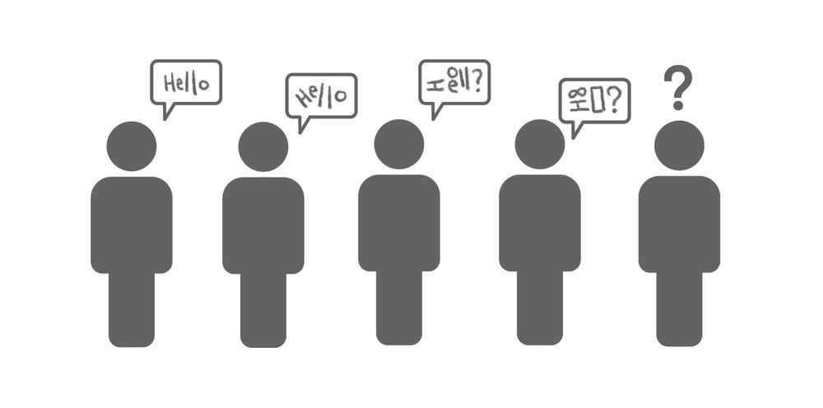
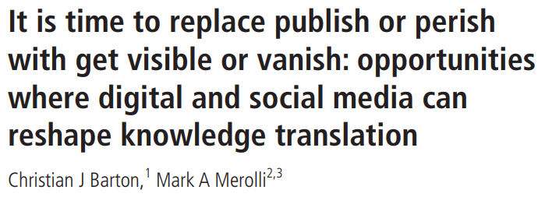
Knowledge translation
“The synthesis, exchange and application of knowledge by relevant stakeholders to accelerate the benefits of global and local innovation in strengthening health systems and improving people’s health”

Slide 4
Barriers to knowledge translation
Unengaging Content
Comprehension
Restraints
Lack of understanding
Scientific writing
Scientific jargon
Dry Content
Too much text
Partial read
Time to read article
# of articles published
Time available
Lack of access
= ‘disconnect’ between researchers and end-user(s)!
Notes:
This creates a major (perceived and/or real) ‘disconnect’ between researchers and end-users (in many cases clinicians/patients)

Slide 5
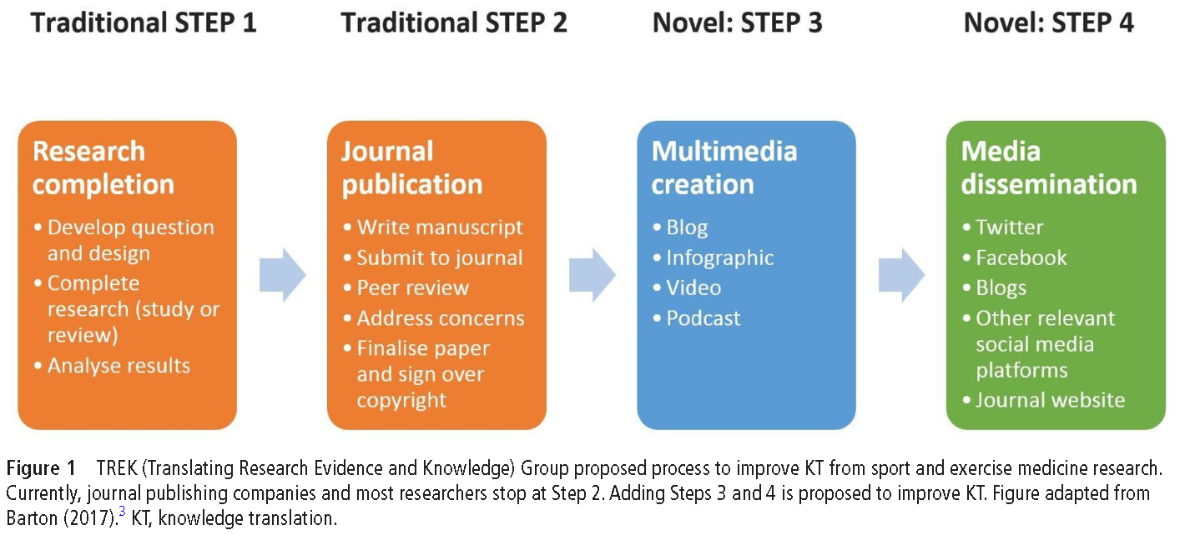

‘Get visible or vanish’

Slide 6
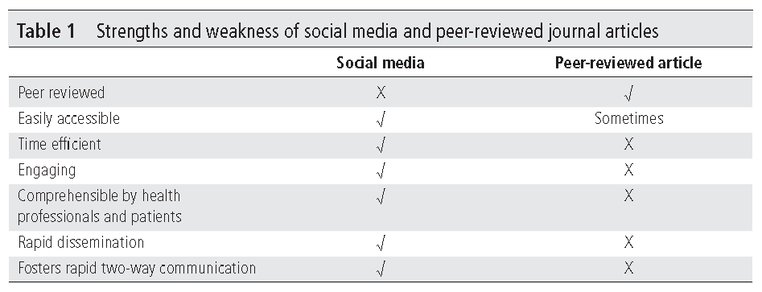

Social media vs. peer-review

Slide 7
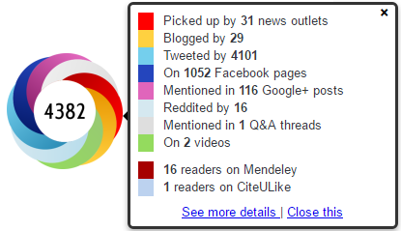
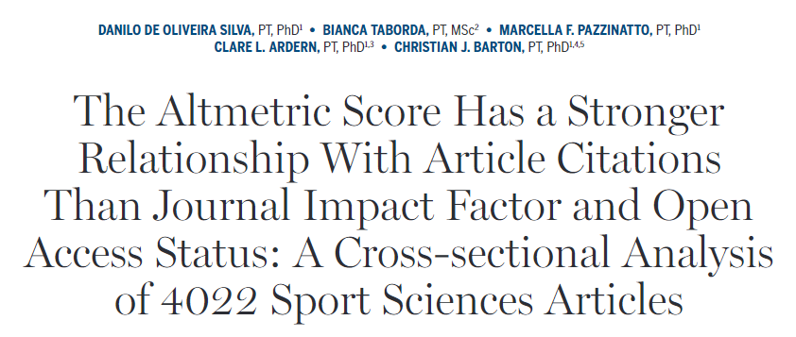


If you didn’t tweet it, did it even happen?
Implications: sharing research via social media and mainstream media may assist with reach of work…Twitter may be the best platform!
Notes:
Altmetric attention score
Record of attention (exposure/engagement with work)
Measure of dissemination (where/why work is being shared)
Influence and impact (on field/policy/expert opinion)
Advantages
Quicker than citation-based metrics
More robust than citation-based metrics
Apply to more than journal articles

Slide 8
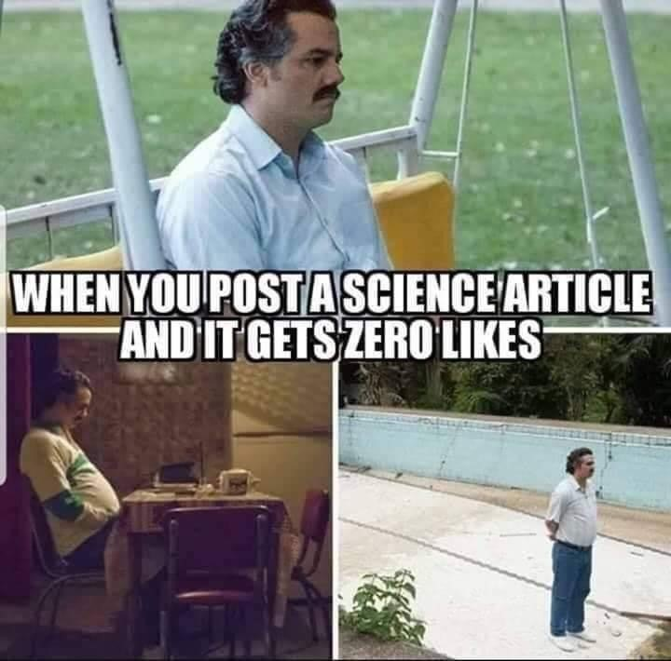
But…I tweeted it

Slide 9
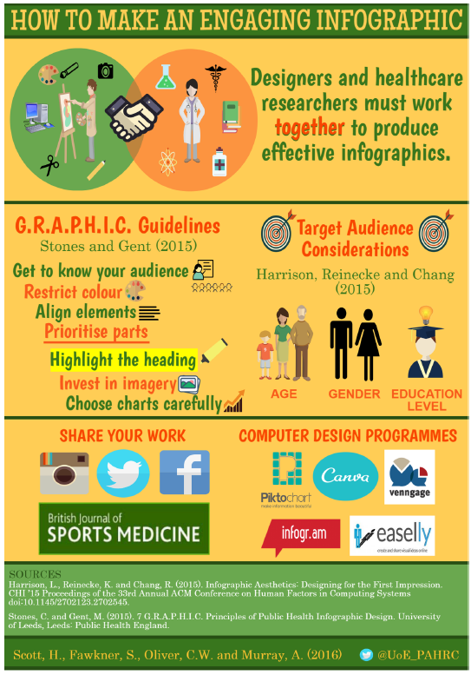
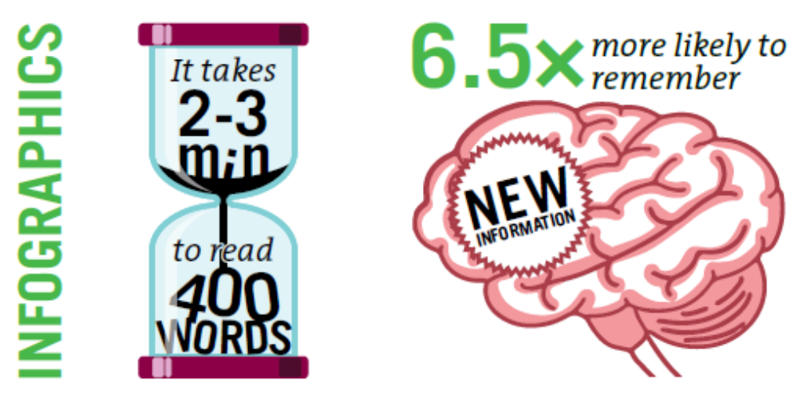
infographics
Articles with visual abstracts are 3x more likely to be viewed!
Scott H et al. How to make an engaging infographic? Br J Sports Med. 2017
https://pubmed.ncbi.nlm.nih.gov/28039124/
Notes:
Information graphic
Definition: An infographic is defined as a visualization of data or ideas that tries to convey complex information to an audience in a manner than can be quickly consumed and easily understood
Goal: use images and/or data visualizations to present research in an engaging way, which adds value by increasing the understanding and reach of the work
Fun facts:
Information is more likely to be retained if learned from an infographic than text along…6x more likely to remember!
Articles associated with a visual abstract are 3x more likely to be viewed than those with text-only abstracts
Increases Altmetric score…which means, more viewers!

Slide 10
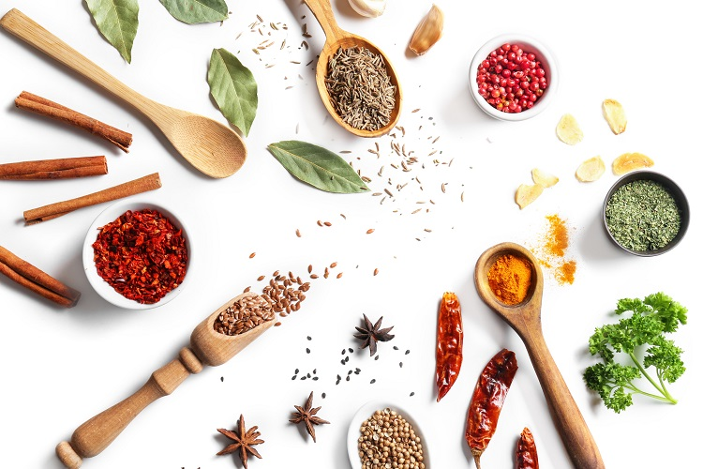
Key Ingredients
Know your audience
Seek input (inside/outside of design team)
Create balance between visualizations, images, and text
Use text sparingly
Apply the ‘no text’ test***
Use no more than 3 font types or 3-5 complimentary colors
Check out more examples: https://ylmsportscience.com/

Slide 11
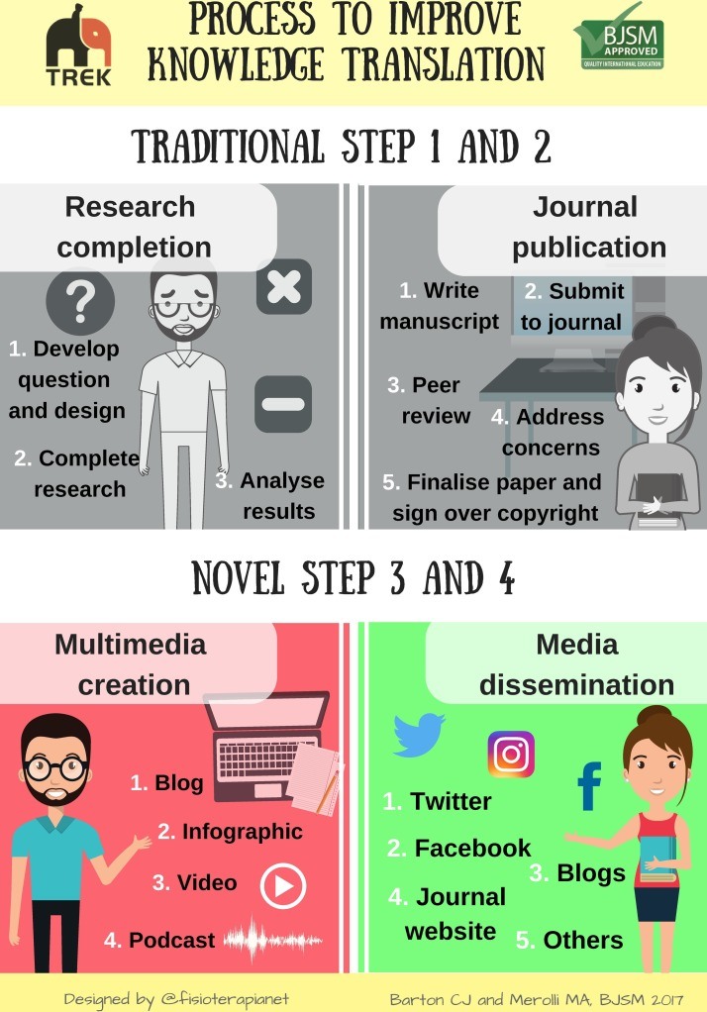
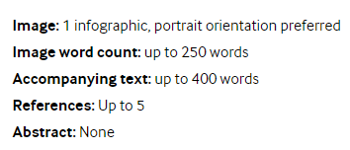
BJSM Guidelines
Notes:
JOSPT is now publishing infographics as well, more informal process than BJSM

Slide 12

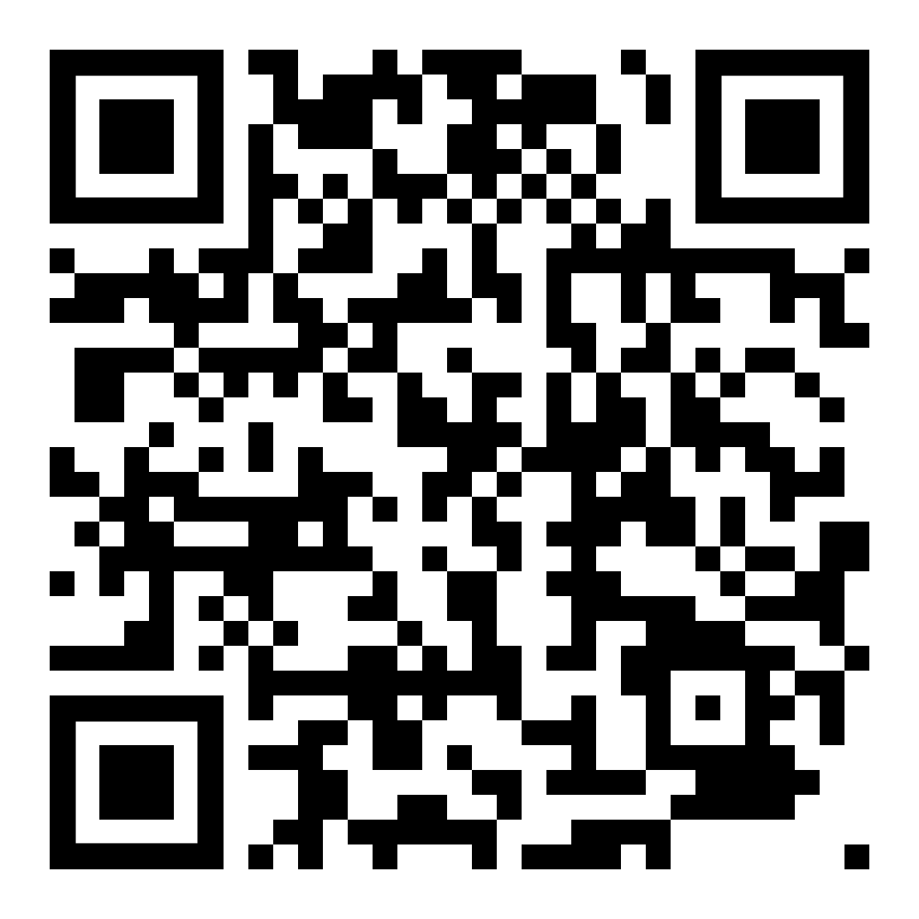
Computer programs
Freeware
PowerPoint
Canva
Piktochart
Venngage
Easel.ly
Infogr.am
Visualize
Creately
Visme
Good Charts
Pablo
Adobe Sprak
Snappa
Online libraries
Shutterstock
Pixabay
Scan to review more on freeware
Joshi and Gupta, J Korean Med Sci, 2021
Notes:
Free versions of most
Online libraries of graphics and illustrations (free options)
Shutterstock
Pixabay

Slide 13
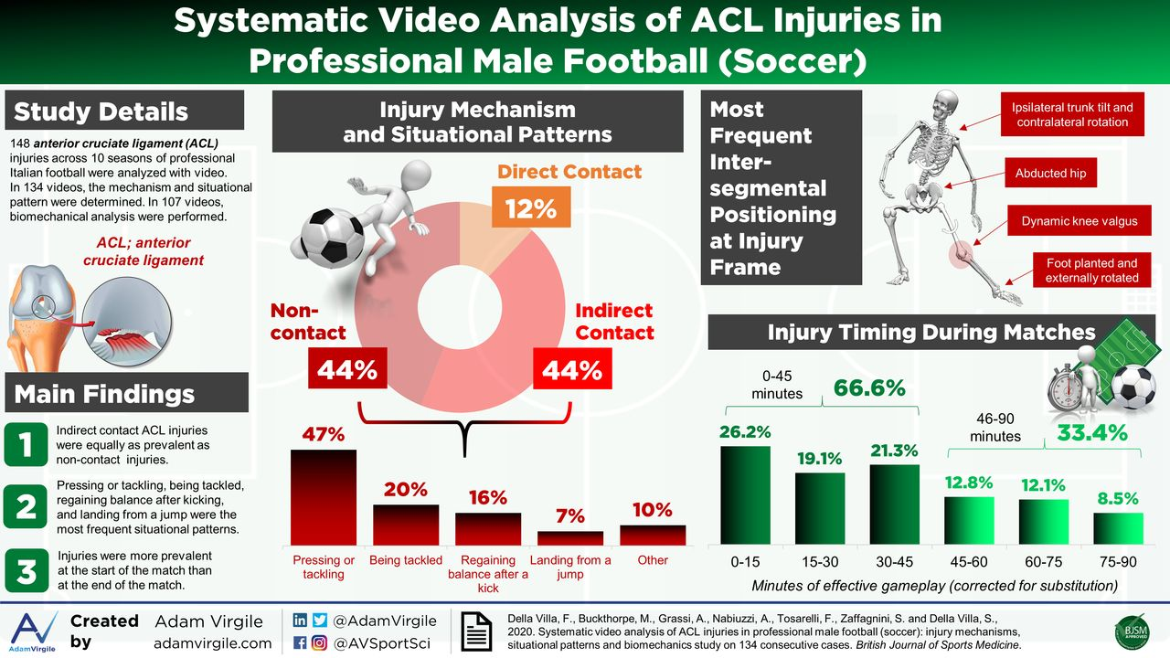

Know audience
Create balance
Use text sparingly
Limited fonts/colors
Notes:
PowerPoint
Intended audience: researcher/educator, clinician

Slide 14

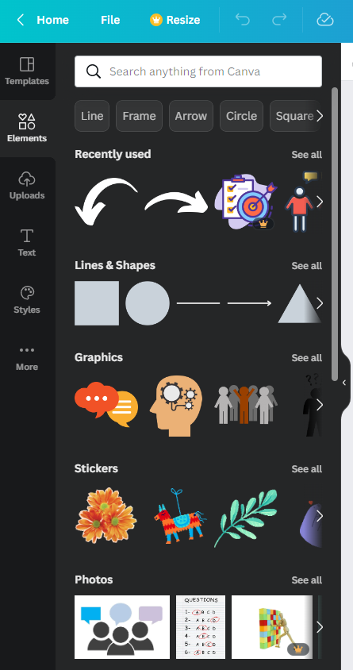
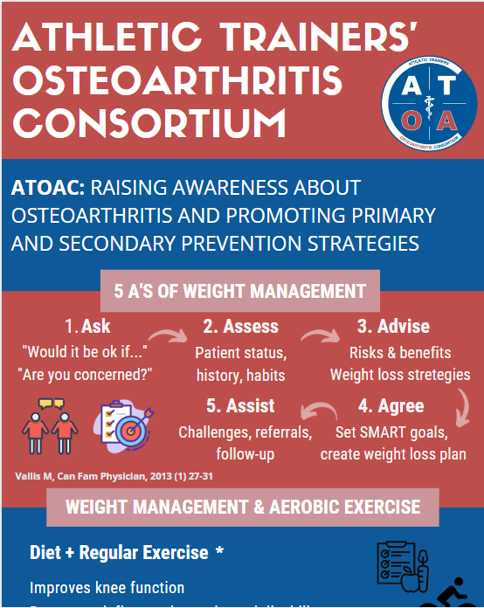
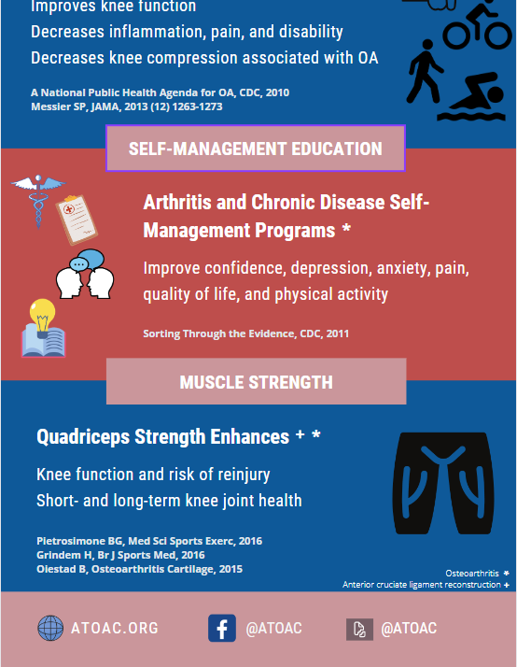
Creating the infographic
Notes:
Intended audience: patient, clinician, educator

Slide 15
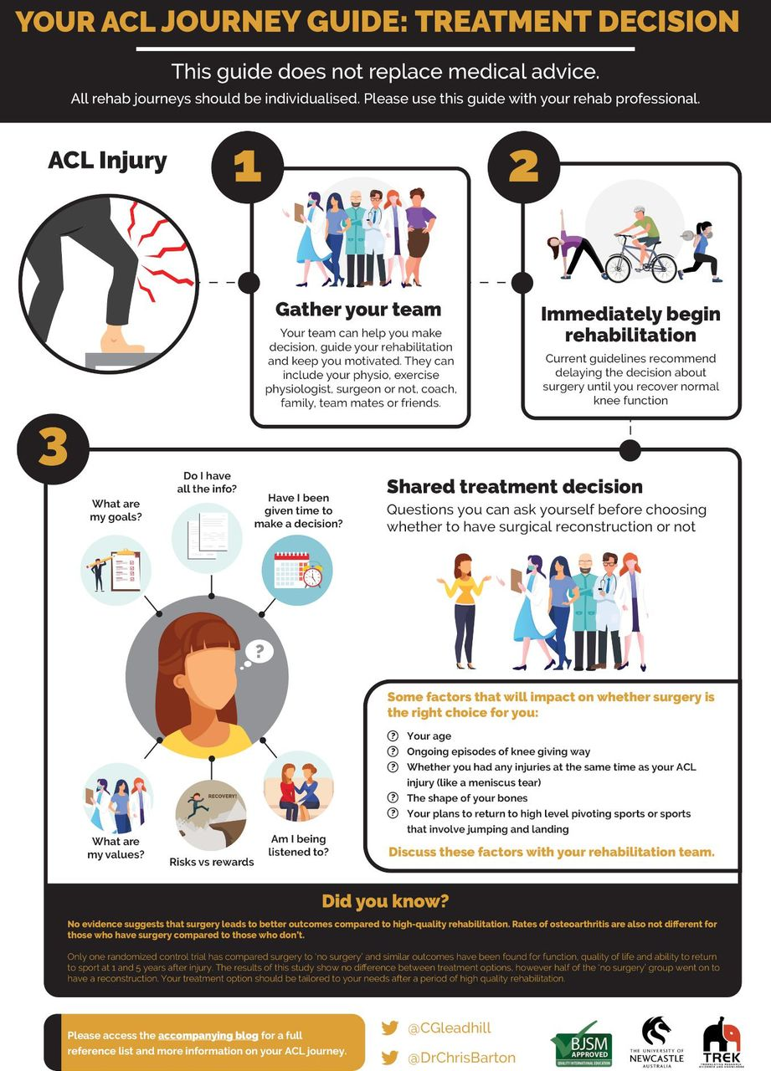
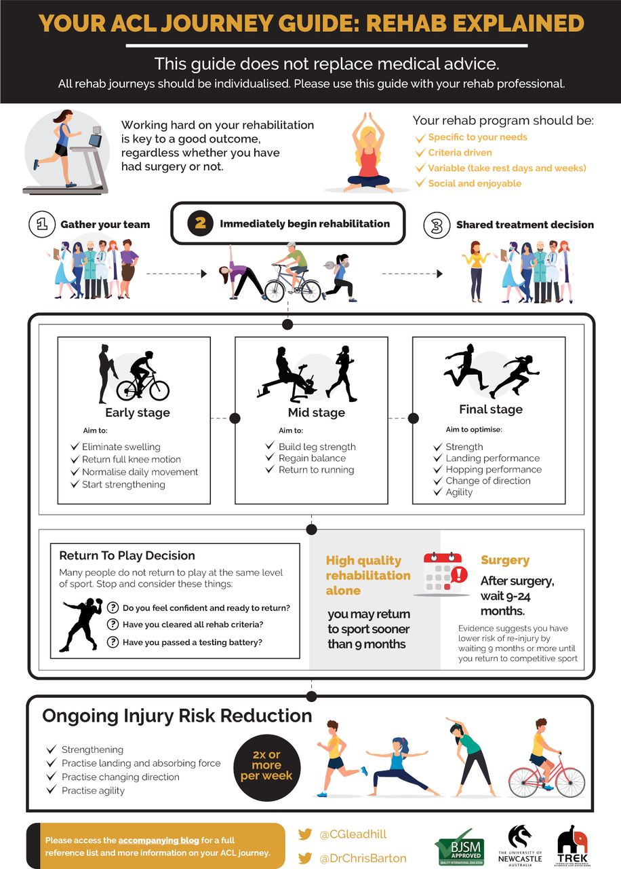
Notes:
Intended audience: patient

Slide 16




Additional media
Video-based content
Podcast
Blog
Translating the research is key!
Sports Medicine Research (SMR): In the Lab & In the Field
JAT Chat, The AT Tapes, JAT Cast
JOSPT Insights, JOST blog, infographics
BJSM blog, infographics
ATOAC: video summaries, simulated patient cases, infographics

Slide 17
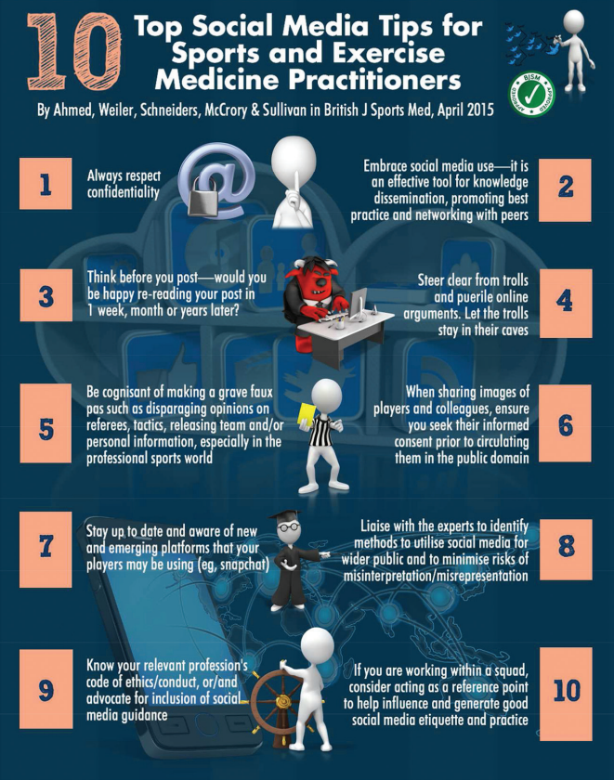

Best practices in social media
Etiquette matters
Think before you ‘tweet’
Embrace it

Slide 18

TAKE HOME
Digital multimedia and social media are necessary to enhance knowledge translation…embrace it!
Avoid a ‘one size fits all’ approach…tailor your content to the needs of the work!
Keep the end-user in mind when designing content…that’s who matters!
@Grant_Norte
Grant.norte@utoledo.edu

