Slide 1
Athletic Trainers’ Osteoarthritis Consortium (ATOAC)
10th Annual Meeting

Slide 2
Membership Report
ATOAC formally established with bylaws
*Membership numbers as of June each year

Slide 3
Online Presence
 | 2014 | 2015 | 2016 | 2017 | 2018 | 2019 | 2020 | 2021 | 2022
Twitter followers | - | 63 | 154 | 320 | 501 | 613 | 722 | 819 | 894
Website page views | 816 | 2537 | 3056 | 2473 | 1978 | 2256 | 1731 | 2017 | 873*
*as of June 27

Slide 4
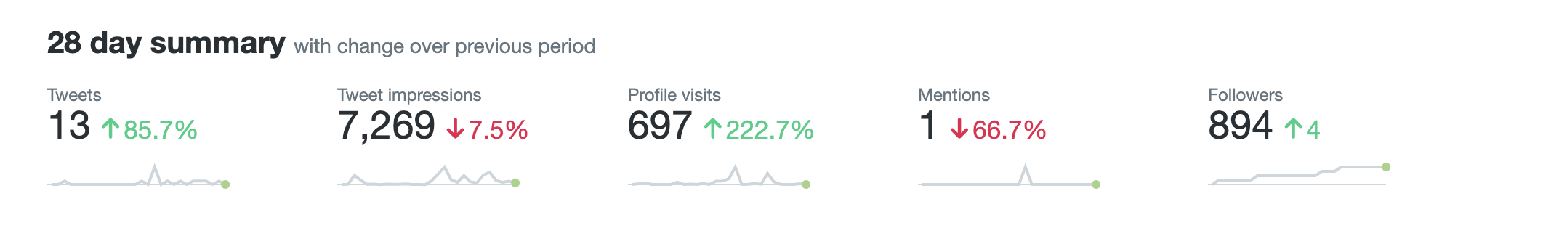
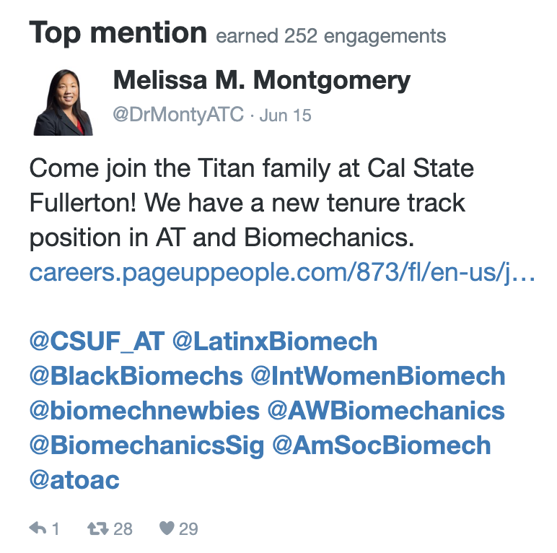
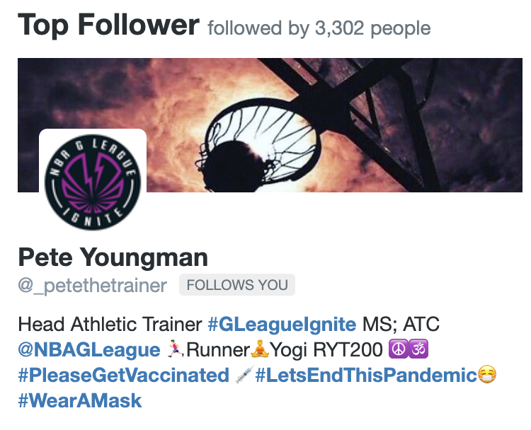
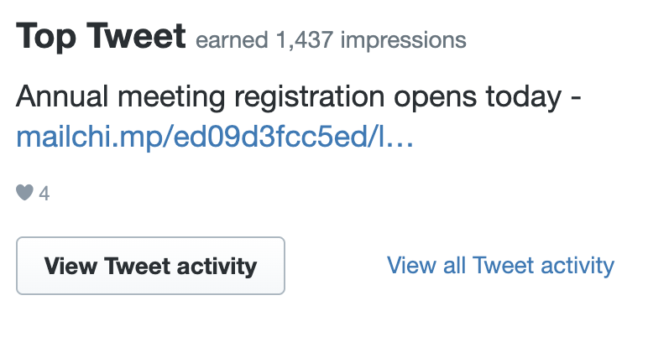
Online Presence

Slide 5
Executive Committee
Executive Committee
Chair: Abbey Thomas, Vice Chair: Hanna Hoch, Treasurer: Chris Kuenze, Secretary: Janet Simon, Member-at-Large: Jenny Hunnicutt
Public Relations and Collaboration with Other Organizations
Chair: Hanna Hoch
Raising Awareness of OA
Chair: Janet Simon
Promoting Collaboration Among ATOAC Members
Chair: Chris Kuenze
Annual Meeting Program Committee
Chair: Jenny Hunnicutt
Finance Task Force
Chair: Chris Kuenze
Student/Young Professional Task Force
Danielle Torp: recruitment
vacant: newsletter
Justin Rush: social media
Katie Collins: website

Slide 6
Updates
Public Relations & Collaboration with Other Organizations
  Accomplishments
    ATOAC has been given the opportunity to support two sessions at IAS.
      The call was sent on, the deadline is June 30th
      The ATOAC sessions are still requested with the change in IAS format.
    We will continue to engage with the educational arm of the CAATE, as the new committees have now been formed.
(Hanna Hoch, Stephan Bodkin, Dana Golden)

Slide 7
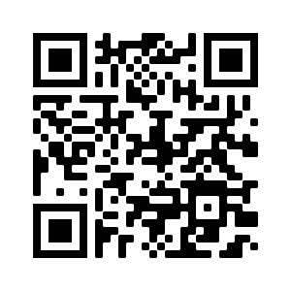
Updates
Raising Awareness of OA
  Accomplishment
    Standardized patient cases for PTOA went live in Fall 2021
      Simulated pt case + accompanying videos
  Developed 1st infographic to raise OA awareness
    2 more in development
  Completed all Harvest working groups
    Working on final write up for submission to JAT
(Janet Simon, Grant Norte, Kyle Kosik)
Links to standardized pt cases

Slide 8
Updates
Promoting Collaboration Among ATOAC Members
  Accomplishments
    Continuing planning for research interest groups based on PRISM RIG system
      Build limited number of interest groups to facilitate focused collaborative research initiatives within ATOAC
(Chris Kuenze, Adam Rosen, Matt Hoch, Kenny Lam)

Slide 9
Updates
Annual Meeting Program
  Accomplishment
    This meeting!
    Stay tuned for feedback survey after the meeting
  Currently 16 members in this group. Contact Jenny if interested in joining
(Jenny Hunnicutt)

Slide 10
Updates
Student/Young Professional Task Force
  Goals
    Identify a new student/young professional to lead this task force
(Danielle Torp, Katie Collins, Justin Rush, Oliver Silverson)

Slide 11
Finance Report
 | Amount | Start Date: 1/1/22 End Date: 6/19/22 Notes
Beginning balance | $3,198.10
Registration and donations | $789.68
Interest earned (since 1/1/22) | $11.00
Wordpress registration | ($18.00)
ATOAC badge tags | ($63.27)
Current balance | $3,917.51
Funds will go toward 2023 Annual Meeting, obtaining BOC Approved Provider status

Slide 12
ATOAC Website
Ongoing updates to posts and pages
Please send any feedback on the website to Katie Collins (colli784@msu.edu)

Slide 13
Affiliate Updates
OARSI
  OARSI Discussion Group recently held an infographic competition related to OA Prevention. /https://oarsi.org/sites/default/files/docs/2022/winning_infographic_-_reducing_joint_injuries_in_female_football_v2.pdf
OAAA
  entering beta testing for their new Remain in the Game Injury Prevention App this summer. The Alliance is looking for volunteers to help beta test the app.
  submitted a consensus statement on secondary prevention of OA after an ACL injury to the Journal of Athletic Training. If interested in helping disseminate contact Jeff Driban (Jeffrey.driban@tufts.edu).
  expanded its OA Care Tools Education Toolkit.
NATA
  OAAA leadership had call with NATA President. Seems interested in efforts to raise awareness of OA

Slide 14
Looking Ahead
Executive Committee Q2 Meeting
  June 28 at 4pm ET
NATA 2023 session proposal deadline July 22
Elections for 2 executive committee positions
  Chair
  Treasurer

Slide 15
Kudos
2022 The Dr. Freddie & Mrs. Hilda Pang Fu New Investigator Award
  Lindsey Lepley
2022 NATA Foundation Grant Awardees
  David Bazett-Jones, PhD, ATC, CSCS
    The Influence of Training Loads on Running-Related Injuries in High School Cross-Country Runners: A Prospective Study
  Matt Harkey, PhD, ATC
    Clinically Accessible Strategy for Monitoring Effusion-Synovitis and Walking Biomechanics to Predict Early Osteoarthritis Symptoms Following ACL Reconstruction
  Justin Rush, MS, ATC
    Neurocognitive Performance and Dual-Task Cost After Anterior Cruciate Ligament Reconstruction
  Oliver A Silverson, MS, ATC
    Effects of exposure to strenuous shoulder activity on glenohumeral and scapulothoracic kinematics in competitive swimmers with glenohumeral instability

Slide 16
Please Let Us Know
About
  Publications
  Grants & awards
  Presentations (especially EBP)
  Positive press coverage
What we can do for you
Ideas about moving ATOAC forward
NATA Annual Meeting proposals

Slide 17
Don’t Forget
Promote #ATOAC on social media

