Slide 1
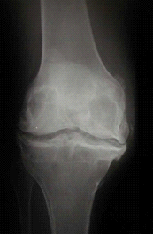

The Development & Progression of OA:
A Path to Joint Failure
Jeffrey B. Driban, PhD, ATC, CSCS
Division of Rheumatology
Tufts Medical Center
June 28, 2012
Notes:
Good morning and thank you for coming in so early in this morning.
I’ll be discussing the development and progression of osteoarthritis: a path to joint failure.

Slide 2
Overview
Defining Osteoarthritis (OA)
Risk Factors and Onset of Osteoarthritis
Early-Stage Osteoarthritis & Progression
End-stage Osteoarthritis (Joint Failure)
Summary
Notes:
Today, I’ll begin by briefly defining osteoarthritis based on the latest research, describe risk factors for osteoarthritis, and then progress into the onset and progression of osteoarthritis.

Slide 3
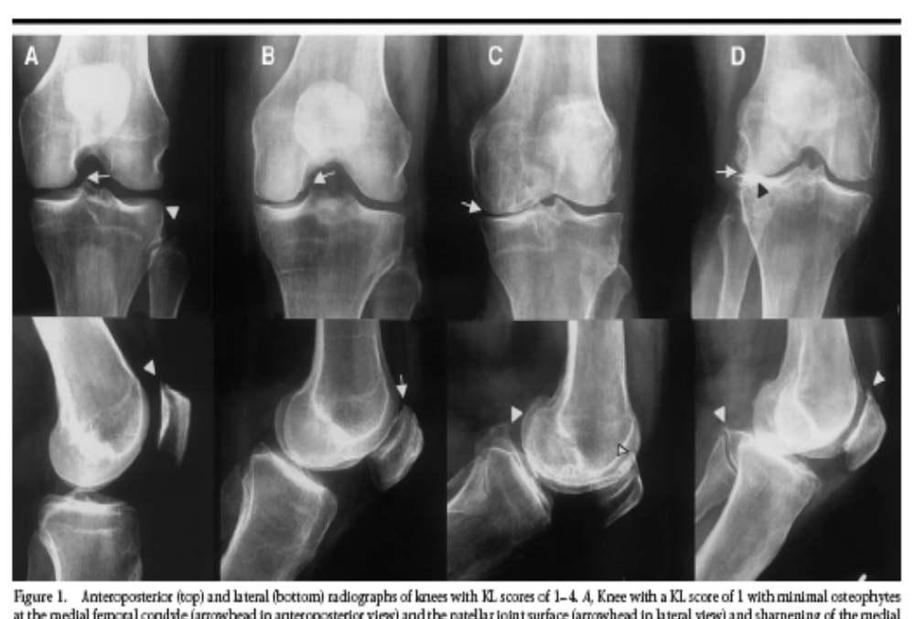
Definition
A traditional view…
Link et al., 2003
Notes:
OA has traditionally been assessed based on radiographs and characterized by a loss of joint space, osteophytes, and sclerosis of the bone

Slide 4
Definition
A complex disease characterized by structural changes throughout the joint¹
An illness defined by patient-reported symptoms¹
A set of phenotypes (e.g., subsets, conditions, diseases) with a common endpoint²
1 Lane NE et al. 2011
2 Zhang W et al. 2009, Driban et al. 2010, Felson DT 2010, Kapoor M et al. 2010, Kraus VB et al. 2010, Bijlsma J et al. 2011
Notes:
In more recent years, it has become more appreciated that osteoarthritis is not just a disease of the bone and cartilage but a complex disease characterized by structural changes throughout the joint as well as an illness of the whole patient defined by patient-reported outcomes like pain and stiffness.
Furthermore, many believe that osteoarthritis may be a syndrome or collection of diseases characterized by a set of phenotypes or subsets that happen to have a common endpoint which is joint failure.
Based on this working definition of osteoarthritis, today I’d like to highlight how osteoarthritis involves the entire joint and may not be as simple as we used to think.

Slide 5
Potential Risk Factors
Sex
Age
Genetics
Obesity / Diet
Joint Trauma
Malalignment
Bone Shape/Density
Occupation
Muscle Strength
Biochemical
Factors
For example:
Inflammation
Hormones
Biomechanical
Overloading
Recommended Reading: OARSI Online Primer on Osteoarthritis (http://primer.oarsi.org/)
Notes:
To start I’ll briefly describe some of the risk factors that lead to the onset of osteoarthritis.
When we look at the potential risk factors for osteoarthritis; for example sex, age, genetics, obesity, etc; we can interpret them in many ways but for me I see them as highlighting the link between biomechanical overloading and biochemical factors, which might include inflammation and hormones.
For example, as we age the amount of repetitions our joints have experienced increase but so to does the amount of inflammation in our body.

Slide 6
Linking Biomechanics+Biochemisty
Macrotrauma induces
inflammation &
catabolic cascade but…
So can high-repetition, high-force tasks with inadequate rest intervals
  Certain occupations or elite sports as well as other
  factors may increase joint loading
Sex
Age
Genetics
Obesity / Diet
Joint Trauma
Malalignment
Bone Shape/Density
Occupation
Muscle Strength
Biomech
Biochem
Elsaid KA et al. 2009, Catterall JB et al. 2010, Driban JB et al. 2011
Notes:
As an example of how biomechanical conditions and biochemical conditions are entwined, we can take an example that we’re used too and I suspect that no one in this room would question that an ACL tear typically involves a high force load that is subsequently followed by inflammation.
The exposure to a high load injury and inflammation can predispose the joint to degeneration.
But even in the absence of a high load event, high-repetition high-force tasks with inadequate rest intervals may also lead to inflammation and joint degeneration.
This might explain why certain occupations or certain elite athletes seem to have an increased risk for osteoarthritis.

Slide 7
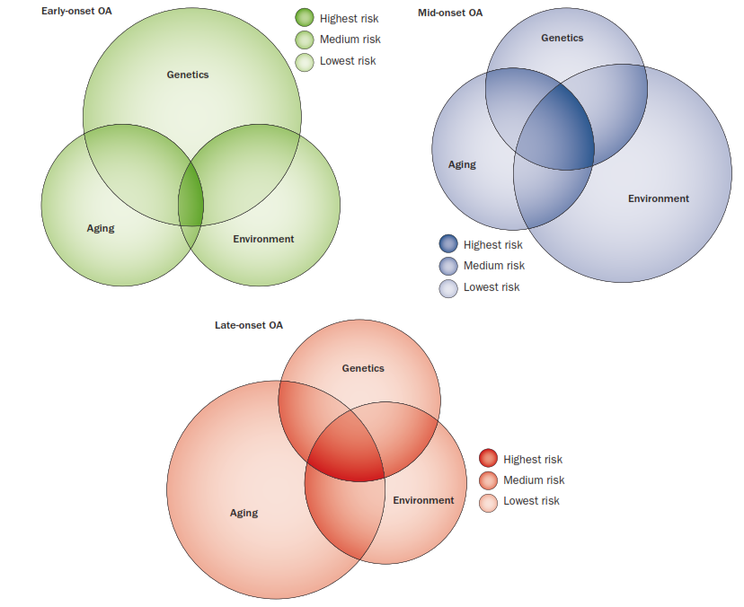
An Alternative View
Early-onset OA
Mid-onset OA
Late-onset OA
Sandell L 2012
Notes:
Now, I’ve suggested that we can look at many of the risk factors for osteoarthritis as having a mechanical and biochemical impact on the joint which then leads to an increased risk of osteoarthritis but this is not the only view.
On the screen is an alternative way of conceptualizing risk factors for osteoarthritis. In this paradigm Dr. Sandell classifies risk factors into three groups: aging, genetics, and environmental which could include joint trauma.
Dr. Sandell takes this a step further and shows how these three groups of factors can interact to increase a person’s risk of developing osteoarthritis (the darker regions) and how the influence of certain groups of risk factors might change depending on whether the person develops osteoarthritis early in life or late in life (represented by the size of the circles).
So in this example, genetics, particularly those that influence the shape of the joints, might be important influential factors for developing early-onset OA but as we look at mid-onset OA we see a shift to environmental risk factors like injuries.

Slide 8
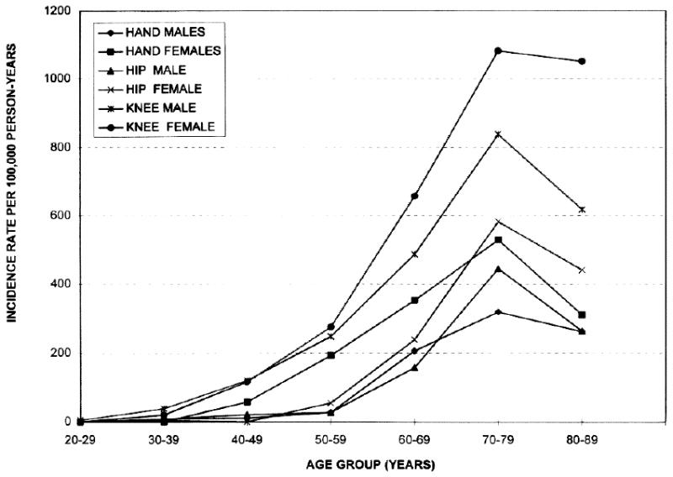
Incidence of OA as We Age
Oliveria SA et al. 1995
Notes:
Now regardless of which risk factors are involved we typically detect a trend that as we age the incidence rate of osteoarthritis continues to climb until we turn 80 to 89 years of age.
In fact, over a third of senior citizens have osteoarthritis (Lawrence RC 2008).
SYMPTOMATIC OA

Slide 9
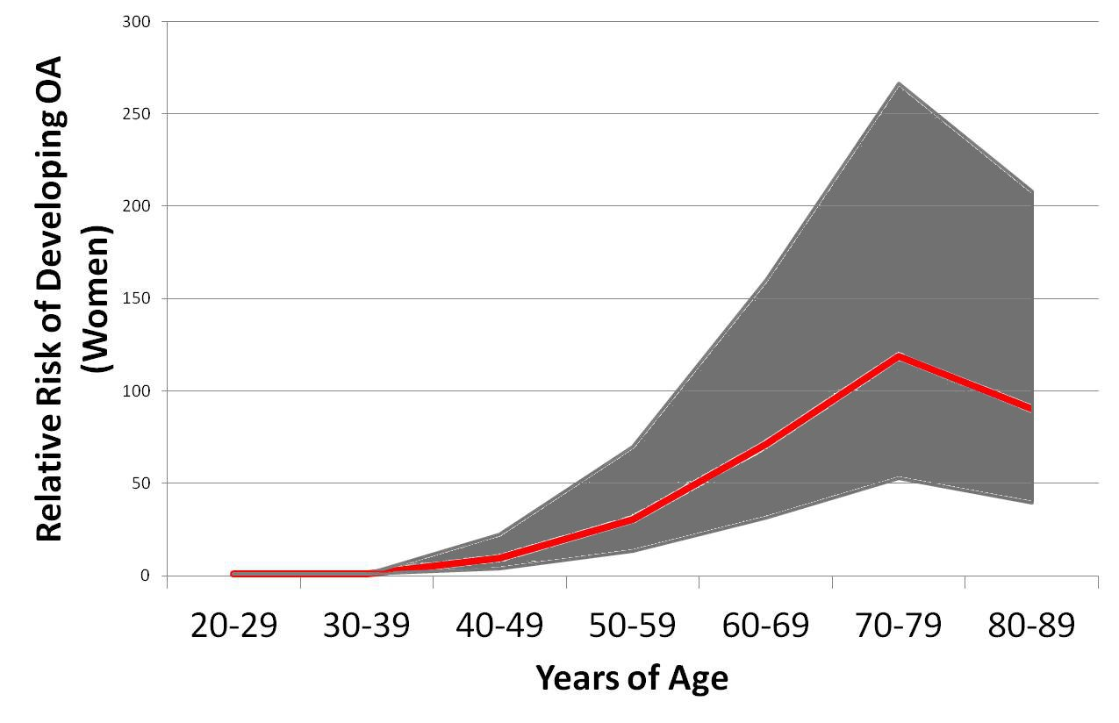
Standard Warranty
Risk Factor Example:
Genetics
Obesity
Joint Trauma
Excessive Overloading?
“The warranty does not cover damage caused by accident, misuse, abuse, failure to follow instructions given in the product documentation,… external environmental causes…”
Notes:
One of the key questions you might be asking is what leads one person to develop osteoarthritis at 50 years of age versus 65 years of age.
What puts us on this top yellow line versus putting us on this bottom yellow line. While many of us are given resilient joints the warranty may become void when we have an injury or overload our joints with insufficient recovery.
Furthermore, the more risk factors we pile onto our joints the more risk we have of failing earlier but this is also something we can use to our advantage.
For example, if our patient has sustained a joint injury then we should educate them about their risk for osteoarthritis and encourage them to reduce their other risk factors, for example avoiding obesity and avoiding a sedentary lifestyle.
The mean age of physician-diagnosed knee OA onset fell from 72 ± 12 years (mean ± standard deviation) in the 1990s to 56 ± 18 years in the 2010s.
Losina E 2011 ACR abstract
http://www.rheumatology.org/about/newsroom/2011/2011_ASM_01_knee_osteoarthtiritis.asp

Slide 10

Onset of Osteoarthritis
Where do we begin?
It’s not just
primary OA
&
secondary OA
Notes:
Once we can appreciate that there are numerous risk factors for osteoarthritis and that we might be able to modify some of them then the next question is really how does osteoarthritis begin?
A lot of times we separate osteoarthritis based on osteoarthritis that we can attribute to an injury or event, this would be secondary osteoarthritis, or osteoarthritis from an unknown cause, often referred to as primary osteoarthritis. The problem with this is that it may be over simplifying things to much.

Slide 11

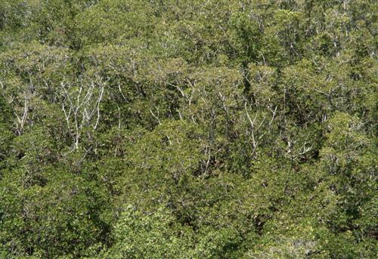
How Does OA Begin?
It may depend on contributing risk factors, involved joints, and which tissue begins to fail first.
Cartilage
Lesion
ACL
Tear
Meniscal
Tears
Notes:
In fact, the type of osteoarthritis and how it begins might be influenced by the risk factors that contributed to the joint change, the involved joints, and which tissues begin to fail first.
So it is possible that patients start on discrete paths to joint failure but the problem is that when we look at patients as a whole, particularly when we look at patients with radiographic osteoarthritis, we kind of lose the trees by taking a 30,000 foot view on things.
Pictures from maine.gov and gallery.usgs.gov
It may depend on contributing factors, involved joints, and which tissues begin to fail first but this is challenging to assess b/c as the disease progresses these paths to failure may merge to give us a picture that hides the underlying complexity.

Slide 12
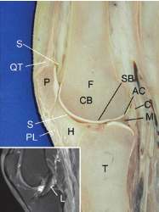
Genesis Theory of Phenotypes
OA phenotypes may be defined by the tissue that is initially compromised
  Chondrogenic (cartilage)
  Osteogenic (bone)
  Ligamentogenic (ligaments)
  Synoviogenic (synovium)
  Meniscogenic (meniscus)
  Mixed pattern disease
The clinical relevance of this needs to be tested
McGonagle D et al 2010
Notes:
In fact, a few years ago, McGonagle et al proposed that rather than primary and secondary osteoarthritis it might be more relevant to characterize osteoarthritis based on which tissues were initially compromised.
So for example, a patient with an isolated ACL tear might be considered a ligamentogenic osteoarthritis since the ligament was the first tissue compromised.
Or another example is a patient with an isolated meniscal tear could be characterized as a meniscogenic form of osteoarthritis.
While this is an interesting idea it remains unclear how common these potential subsets are, how we can figure out which subset a patient belongs to, and whether this will be a way of stratifying patients that has clinical implications.

Slide 13
Does the Cause Matter?
Macro-trauma versus other causes for OA
  Age: post-traumatic OA < other-causes OA
    Hip = 9.0 years younger
    Knee = 10.4 years younger
    Ankle = 14.0 years younger
  Anti-oxidant enzyme activity
    Post-traumatic OA > other-causes OA
  Synovial fluid viscosity
    Post-traumatic OA < other-causes OA
Altman et al., 1986; Brandt et al., 2009; Brown et al., 2006; Lohmander et al., 2007; Ostalowska et al., 2006; Ratcliffe et al., 1998; Roach et al., 2007
Notes:
So with that said you might be wondering if this stuff even matters. It’s definitely very early in the game to figure out how defining these subsets of patients based on their risk factors, initially involved joints, or initially involved structures may be important but there is some evidence to indicate that they may be clinically meaningful.
For example, when we compare joints with and without a history of injury, the joints with a history of trauma tend to develop osteoarthritis earlier than other joints as well as have different biochemical characteristics; for example, antioxidant enzyme activity or synovial fluid viscosity.
I think this is an area that will eventually influence the clinical decision making for some patients and the sports medicine community is well positioned to help study these important questions about the onset of osteoarthritis.

Slide 14
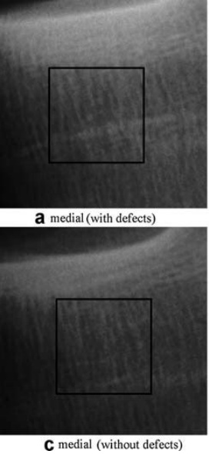
Early-Stage OA: Bone
Early changes in bone either coincide or precede early changes in cartilage¹
Early adaptations may include resorption of subchondral bone ¹
Chondrophytes
Bone below
cartilage damage
Bone below
intact cartilage
1. Sandell L 2012; Goldring SR, 2009; Images: Wolski M et al. 2011
Notes:
Now that I’ve described that there might be several ways osteoarthritis can start depending on the contributing risk factors, involved joints, and initially involved tissues I am going to describe generically the early stages of osteoarthritis and how it progresses.
Keep in mind that some of what I am about to describe could be influenced by what we just discussed but so far it remains unclear how various OA starting points influence the progression of osteoarthritis.
To start, we will look at how bone changes with osteoarthritis. It has become accepted that changes in the bone either coincide or precede early changes in the cartilage.
Beneath the cartilage the initial phase of bone adaptation is characterized by a loss of bone while on the periphery chondrophytes begin to grow and will eventually turn into bone spurs.
8-9 minutes

Slide 15
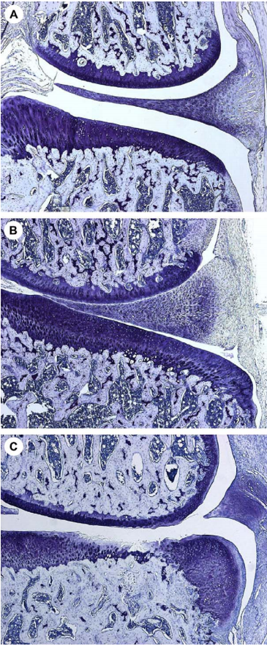
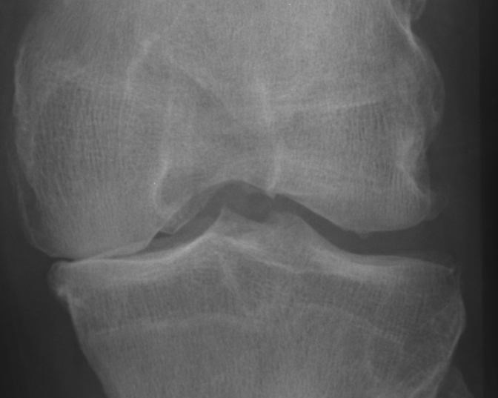
Progression: Bone
Osteophyte (bone spur) formation
  Reactivation of dormant cellular processes¹
Chondrophyte/
Osteophyte
Normal
Osteophyte
1 Goldring SR 2009, Image: Bove SE et al., 2006
Notes:
Over time the chondrophytes mature into bone spurs in a process that mirrors the way that growth plates begin to mature.
For example, in a region of cartilage the cartilage cells and extracellular matrix begin to change, blood vessels grow into the cartilage, and the remodeling occurs converting the region into bone. Eventually we end up with mature osteophytes.
Fig. 5. Histology of sham, MCL sham- and MMT-operated rats 21 days post surgery. Frontal sections of the medial aspect of rat knee joints were stained with Toluidine Blue. (A and B) Sham and MCL sham surgery. Knees have normal healthy cartilage, subchondral bone and synovium. (C) MMT surgery. Prominent chondrophyte/osteophyte present adjacent to severe cartilage
erosion. Chondrocyte loss is complete to the deep zone and signiﬁcant proteoglycan loss can be detected all the way to the tidemark. Extensive subchondral sclerosis and bone marrow ﬁbrosis is present with loss of some bone marrow spaces. No synovial inﬂammation is present. Magniﬁcation x5. Representative of two separate experiments (n = 3-6 rats per group).

Slide 16
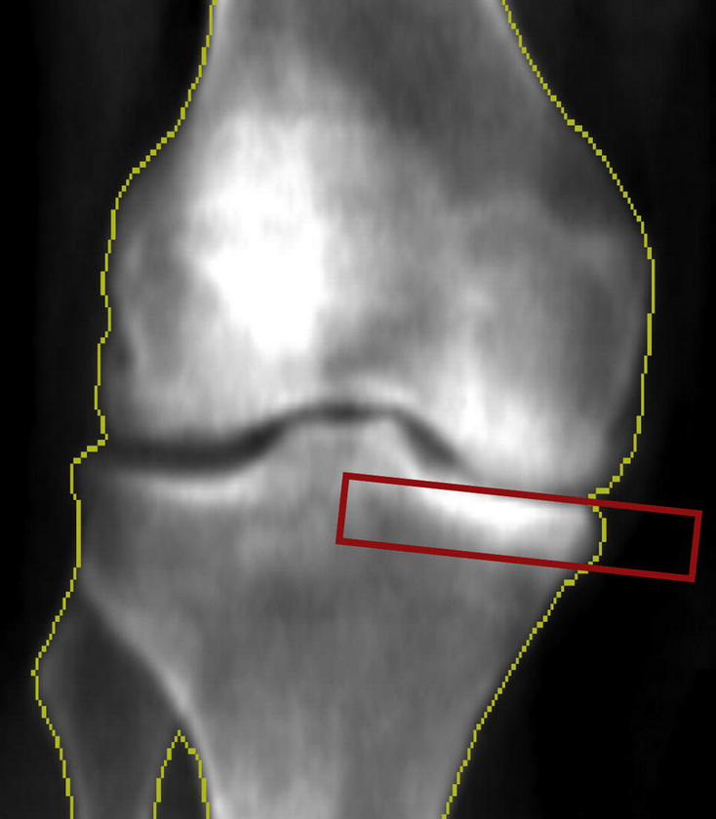
Progression: Bone
Subchondral Changes
  After a period of resorption, anabolic processes begin
  Development of sclerosis¹
    Increased trabecular thickness¹
    Increased trabecular number¹
    Increased bone volume fraction
    May occur in some knees within
    4 years of ACL injury
1. Buckland-Wright et al., 2000; Lo GH et al., 2012
Notes:
While bone spurs are developing, the bone deep to the cartilage begins to progress from a period of bone breakdown to a period of bone formation.
During this period the trabecular structure of the bone begins to change and lead to what we commonly discuss as sclerosis or increased bone density.
These changes in the subchondral bone can occur within the first 4 years after an ACL injury.
Within the sports medicine community, where we have access to patients immediately following joint trauma this switch from bone break down to bone formation raises some interesting questions about whether the stage of disease represents a temporary phenotype or subset and whether we might need to provide different treatments to prevent OA versus slowing the progression.

Slide 17
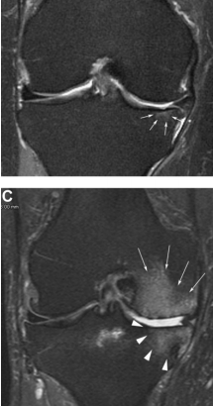
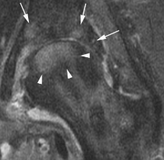
Progression: Bone
Subchondral Changes
  Bone marrow lesions
    Regions of localized bone adaptations
    May be edema or fibrovascular tissue
    Increased trabecular thickness
    Reduced mineral density
Zanetti M et al., 2000; Hunter DJ et al., 2009
Image: Hunter DJ et al., 2011; Roemer FW et al., 2011
Notes:
In addition to generalized bone formation beneath the articular cartilage, we will also often see bone marrow lesions which in these images are the areas of bright signal intensity within the bone.
These regions are commonly characterized by edema or fibrovascular tissue instead of the normal bone marrow.
In addition to changes in the bone marrow these lesions have also been related to thicker trabeculae but these thicker trabeculae have less bone mineral content.
BMLs in some ways may represent a focal region of exaggerated bone changes in an osteoarthritic joint.

Slide 18
Progression: Bone
Subchondral Changes
  Bone marrow lesions
    May be related to loading
    (e.g., joint malalignment,
    meniscal injuries, cartilage lesions)
    Size varies over time
    Related to symptoms
Zanetti M et al., 2000; Hunter DJ et al., 2009
Image: Hunter DJ et al., 2011; Roemer FW et al., 2011
Notes:
What makes these lesions interesting is that they appear to be related to loading.
These lesions are more common in sites that are overloaded due to joint malalignment and co-occur with other structural findings like meniscal or cartilage damage.
These lesions can get larger or smaller over time which may be particularly interesting since they also relate to symptoms which can also fluctuate over time.

Slide 19
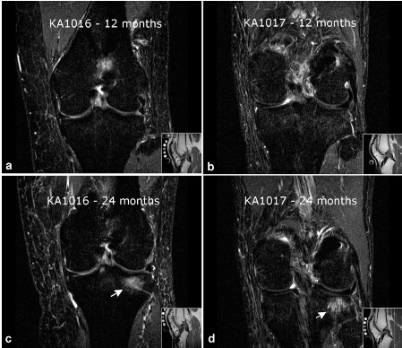
Early-Stage OA: Bone
After an ACL tear
Bone bruises resolve
BUT
Bone marrow lesions emerge over time
12-mo
12-mo
24-mo
24-mo
Frobell R 2011
Notes:
So why might bone marrow lesions be important to us in sports medicine?
Many of us have learned about the presence of bone bruises at the time of an ACL injury and that these typically resolve, but Dr. Frobell recently demonstrated that while the bone bruises typically resolve within 6 months of an injury, 34% of knees developed a new bone marrow lesion within 24-months of an ACL injury.
This raises the question of whether this is an indicator of early degenerative changes and if so what caused these new lesions to develop.

Slide 20
Progression: Bone
So What?
  Diagnostic tests of bone changes may lead to earlier diagnosis and/or prognosis
  Bone marrow lesions are related to cartilage loss and joint symptoms
  Subchondral bone measures relate to disease severity and predict progression¹
We still have a lot to learn
1. Buckland-Wright JC et al., 1996; Kraus V et al., 2009; Woloszynski T et al. 2011; Lo GH et al. 2006, 2012, 2012 (OARSI Abstract)
Notes:
All of these bone changes may be important because they may eventually lead to new diagnostic tests that will enable us to detect early osteoarthritis and possibly predict who is at risk for OA progression.
For example, bone marrow lesions are related to cartilage loss and joint symptoms and subchondral bone measurements, like bone mineral density assessed with knee DEXA scans, relate to osteoarthritis severity and may predict disease progression.

Slide 21
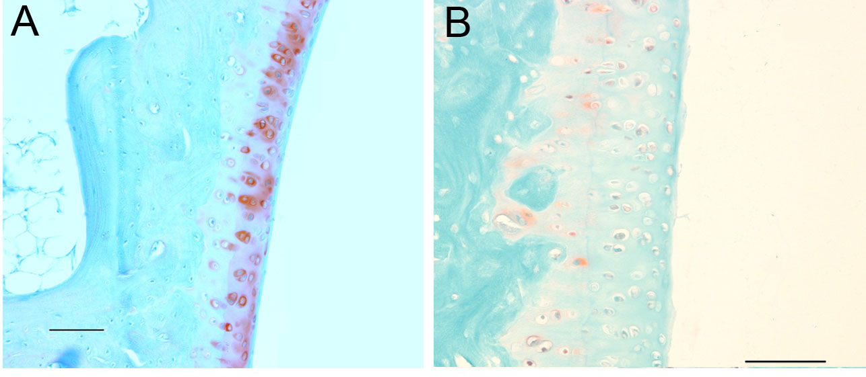
Early-Stage OA: Cartilage
Changes in composition before structure
  Decreased proteoglycans
  Increased water content
  Collagen organization disrupted
Eventually leading to small cracks
Normal
Early
Degeneration
Notes:
As I noted earlier, bone and cartilage undergo changes early in the disease process.
In the cartilage, early changes are characterized by changes in the extracellular matrix. For example, in the images you can see a lack of red staining in the image of cartilage with early degeneration. This lack of red staining indicates that proteoglycans, a key component of healthy cartilage, is greatly reduced compared to the normal cartilage that has red staining.
Early changes to the extracellular matrix allow for the cartilage to swell which can put it at greater risk for degeneration.
Eventually these microscopic changes begin to lead to small cracks into the articular cartilage.
Figure B is the high rep high force group at 12 weeks and demonstrates some key characteristics of the changes in histopatholigical scores. In the circle and throughout the articular cartilage there is a lack of red staining suggestive of proteoglycan depletion. The black arrow is indicating a superficial cluster of chondrocytes and the red arrow is pointing towards pannus, an early sign of structural changes in the superficial layer.

Slide 22
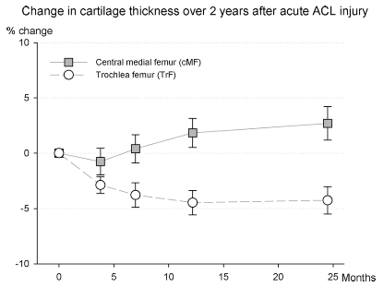
Early-Stage OA: Cartilage
After an ACL tear (a risk factor for knee OA)
  Some cartilage regions thicken (swelling)
  Some cartilage regions thin
Frobell R 2011
Notes:
A good example of early cartilage changes can be seen after an ACL injury where some regions of the knee, like the weight-bearing region of the femoral cartilage, show signs of swelling while the cartilage on the trochlea is getting thinner. But don’t be fooled by the increase in cartilage thickness, it’s probably a bad sign for the future of the cartilage.

Slide 23
Progression: Cartilage
Matrix continues to be further compromised
Chondrocytes try to save the cartilage but fail
  Loading + inflammation ensure eventual failure
  Chondrocytes undergo apoptosis (cell death)
Notes:
As the matrix of the cartilage continues to breakdown the cartilage cells, chondrocytes, desperately try to save the cartilage but to no avail.
The repetitive over loading and inflammation ensures that the chondrocytes are fighting a losing battle.
Eventually the chondrocytes begin to change themselves and eventually fail. As this is occurring the cartilage is being compromised at the superficial and deep regions.

Slide 24
Progression: Cartilage
Superficial cartilage is eroding
Deep cartilage is undergoing dramatic changes
  Blood vessels and nerve infiltration
  Ossification (like a growth plate turning to bone)
Notes:
On the superficial side, the cartilage is slowly eroding while on the deep side, next to the bone, dramatic changes begin to occur that once again remind us of a growth plate or osteophyte.
Healthy cartilage should have no blood vessels and no nerves but as osteoarthritis progresses blood vessels and nerves infiltrate the cartilage from the bone and the cartilage is converted into bone.

Slide 25
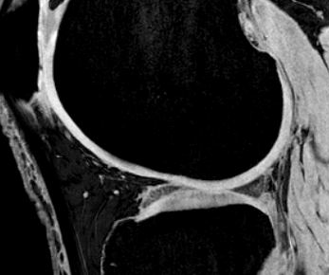
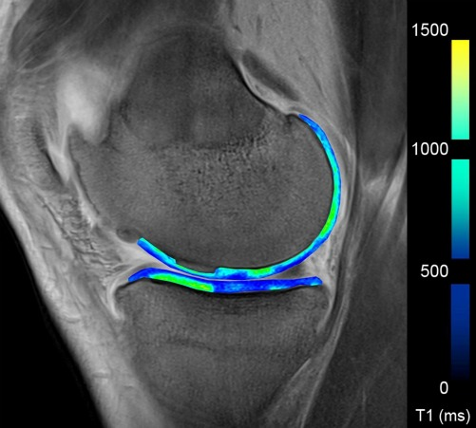
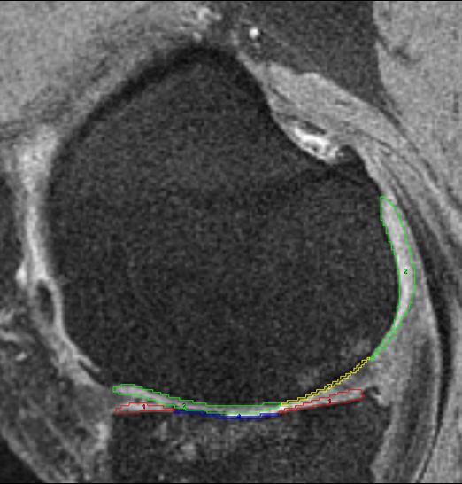
Progression: Cartilage
So What?
  Cartilage may be a key piece in the OA puzzle
    Deep surface in contact with the bone
    Superficial damage produces fragments that may aggravate the synovium
Notes:
Understanding how cartilage is changing in osteoarthritis is important because it’s a tissue that may be a key piece in the osteoarthritis puzzle.
It’s directly touching the bone and then on the other side it’s fragments may be agitating the synovium.
Traditionally, OA has been conceptualized as a disease defined by cartilage loss but by now you’re hopefully starting to see that cartilage change is an important aspect of osteoarthritis that is intertwined with the other tissues.

Slide 26
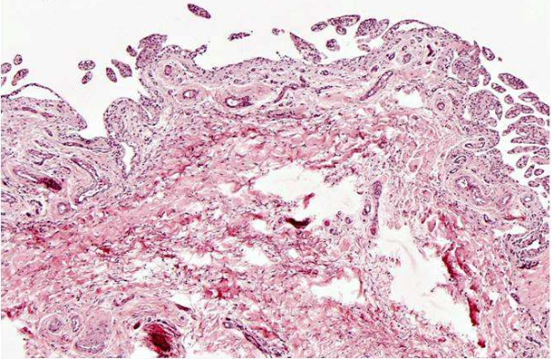
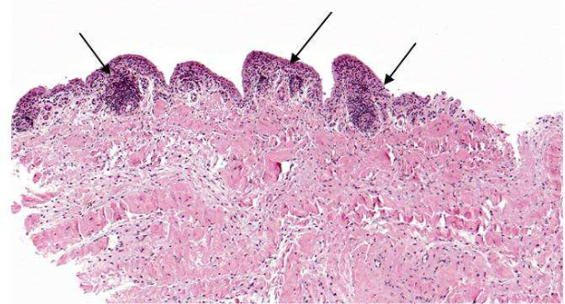
Early-Stage OA: Synovium
Synovium
  ~43% of patients may exhibit low-grade inflammation after a traumatic meniscal tear¹
Synovial Membrane with
No Inflammation
Synovial Membrane with
Inflammation
1 Scanzello CR et al. 2011
Notes:
As I just mentioned the synovial membrane maybe another important aspect of osteoarthritis.
However, it is unclear how early the synovium becomes involved; but almost half of individuals undergoing a partial meniscectomy following a traumatic knee injury show signs of inflammation in their synovium.

Slide 27
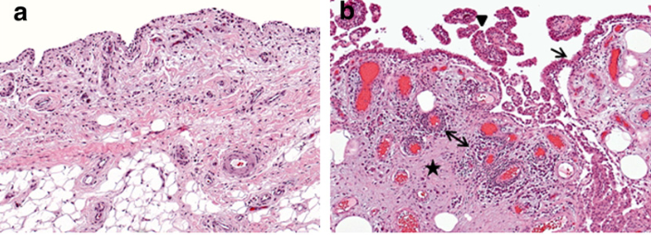
Progression: Synovium
Inflammation
Express inflammatory and catabolic mediators
Increased synovial surface
Increased blood vessels
Increased synoviocytes
Capsular thickening and fibrosis
Normal
Osteoarthritis
Haynes et al. 2002, Linblad & Hedfors 1987, Myers et al. 1990, Revell et al. 1988; Bondeson et al. 2006; Grau et al. 2006, Fernandez-Madrid et al. 1995, Roach et al. 2007; Image: Scanzello & Goldring2012
Notes:
In a degenerating joint the synovium can be agitated by fragments of the cartilage which can cause it to produce more inflammatory and catabolic mediators.
It’s interesting to note that biopsies from knees with osteoarthritis tend to show that about a third to half of knees have notable synovial inflammation and some of these can be quite pronounced.
As the OA progress the synovium has more activated cells, and develops more blood vessels. Furthermore, the synovium gains a larger surface, thickens, and becomes fibrotic.
Figure a depicts normal appearing synovial membrane with a thin lining layer and loose connective tissue subintimal layer. The section in panel b demonstrates synovial lining hyperplasia (arrow), villous hyperplasia (arrowhead), ﬁbrosis (star) and perivascular mononuclear cell inﬁltrates (double-headed arrow) which are histopathologic features often observed in OA.

Slide 28
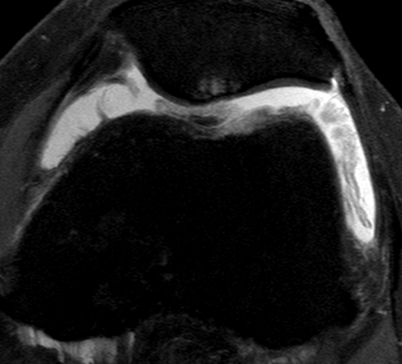
Progression: Synovium
May be stuck in a vicious loop
  Effusion synovitis may promote cartilage breakdown¹
  Cartilage fragments agitate synovium
1. Roemer FW et al., 2011
Notes:
We still have a lot to learn about the role of the synovium but it seems to be key to a vicious cycle in which effusion and synovitis promote cartilage breakdown and the fragments from the cartilage further agitate the synovium.

Slide 29
Progression: Synovium
So What?
  Synovial inflammation is related to disease progression¹
  Capsular fibrosis is related to joint stiffness
  Synovitis/Effusion on MR imaging are related to knee symptoms and cartilage loss²
  It’s the source of synovial fluid
Bondeson et al., 2006; Roach et al., 2007.
Yusuf et al., 2011; Roemer et al., 2011
Notes:
The synovium is important to osteoarthritis because synovial inflammation may be related to disease severity. Furthermore, synovitis and effusion on MRI are related to symptoms and the risk of OA progression.
Finally, changes to the synovium can alter the composition of synovial fluid.

Slide 30

Progression: Synovial Fluid
Normally lubricates and nourishes the cartilage
The Wastelands
  Becomes less viscous
  Contains mesenchymal (multipotent) stem cells¹
  Becomes a depository for cartilage fragments, inflammatory mediators, catabolic mediators, and other proteins
1. Jones EA et al. 2008
Notes:
The synovial fluid is important because it lubricates and nourishes the articular cartilage.
Unfortunately, as OA progresses the synovial fluid become less viscous, which compromises its ability to lubricate the cartilage.
In recent years, it has also become apparent, that at least in the early stages of osteoarthritis, there may be an increase in the number of multipotent stem cells in the synovial fluid. While it remains unclear how these stem cells influence or change with osteoarthritis progression, it does raise questions about whether they could be used to facilitate regeneration in the early stages of joint degeneration.
In addition to an increase in stem cells, the synovial fluid becomes contaminated with cartilage fragments as well as inflammatory and catabolic mediators from various tissues.
Image: http://www.modot.mo.gov/ehp/images/WaterPollution.jpg

Slide 31
Progression: Synovial Fluid
So What?
  The lower viscosity leads to higher cartilage friction (increasing the risk of cartilage loss)¹
  An intermediary that can facilitate progression between joint tissues
  A potential source for diagnostic/prognostic tests
1 Blewis et al., 2007
Notes:
The changes to the composition of the synovial fluid leads to greater cartilage friction and an increased risk of cartilage loss.
Plus it acts as an intermediary that can facilitate progression between the different tissues of the joint.
While this represents a distinct disadvantage for the joint, it may be a potential tissue we can sample to assess the health of the joint and may represent a therapeutic target, as we’ve seen with hyaluronic acid injections.

Slide 32
Early-Stage OA & Progression: Other
Articular structures (e.g., labrum, meniscus)
Ligaments
Musculotendinous Structures
Changes to these structures may increase the risk of OA
These structures may undergo degenerative changes and ultimately fail
OA is not a disease of one or two tissues
Notes:
While I’ve focused on bone, cartilage, and synovium we can’t lose sight of the fact that all of the tissues in the joint become compromised.
This includes articular structures, like the meniscus and labrum, as well as ligaments and musculotendinous structures.
Changes to these structures can increase the risk of OA onset and progression.
For example, meniscal damage can be a risk factor for OA but there is also signs that it’s structure becomes compromised with osteoarthritis, and this may increase the risk of further joint degeneration.
Overall, when a joint begins a path towards joint failure we must be concerned about the entire joint not just one or two tissues.

Slide 33
Progression: Symptoms
Several important aspects to OA symptoms (e.g., pain, stiffness, discomfort)
  Severity
  Frequency (i.e., intermittent, constant)
  Predictability (i.e., predictable, unpredictable)
Intense, unpredictable , intermittent pain has greater impact on quality of life than constant “background” pain
Hawker GA et al. 2008
Notes:
But beyond the specific joint we must not lose sight of the patient overall.
After all, osteoarthritis is not just a disease characterized by structural changes but also an illness defined by patient-reported symptoms and functional limitations.
When we consider the OA symptoms we can discuss them based on their severity, frequency, and predictability.
In focus groups, patients have reported that intense, unpredictable, intermittent pain has a greater impact on quality of life than constant “background” pain.

Slide 34
Progression: Symptoms
Mild-moderate intermittent pain, particularly after a triggering event
Mild constant pain with or without intermittent pain
Moderate to severe constant pain with or without intense intermittent pain
Hawker GA et al. 2008
Notes:
As osteoarthritis progresses, patients often progress from reporting mild to moderate intermittent pain, particularly after an agitating event, to more constant mild pain.
Eventually the patient complains of moderate to severe constant pain with or without intense intermittent pain.

Slide 35
Progression: The Whole Patient
The entire body can contribute and react to OA
  Central nervous system
    Depression and anxiety
    Vagal nerve activity
    (systemic inflammation)
    Alzheimer’s progression?
  Peripheral nervous system
  Other joints?
  Adipose tissue
Pain
The Vicious Cycles
Disability
Hawker GA et al., 2011;
Kyrkanides et al., 2011
Fatigue
Depressed
Mood
Inflammation
Notes:
Besides patient-reported symptoms we also need to consider how OA might impact the rest of the body.
For example, osteoarthritis pain, disability, and fatigue may lead to greater depressed moods which can further propagate a vicious pain-disability-fatigue-depression cycle.
This is also concerning since depression may alter the vagus nerve which could promote systemic inflammation and create an inflammation-depression loop.
This may be particularly troubling if future research verifies a recent animal study that suggested that osteoarthritis accelerated the development of neuroinflammation and may influence the progression of Alzheimer’s Disease.
Even beyond the central nervous system we are just beginning to understand the complex relationship osteoarthritis may have with other tissues and other chronic diseases.

Slide 36
Progression: The Whole Patient
    A component of metabolic syndrome?
Are the typical chronic diseases just innocent bystanders to aging and obesity or are they partners in crime?
Katz JD et al., 2010; Velasquez MT & Katz JD 2010.
Notes:
In fact some have suggested that osteoarthritis should be considered a component of metabolic syndrome.
As we learn more about how OA is related to other chronic conditions like diabetes and obesity we are faced with a growing question: Are the typical chronic diseases just innocent bystanders to aging and obesity or are they partners in crime propagating each other along. If they are interconnected, then after joint trauma what else might the patient be at increased risk for besides osteoarthritis?
This highlights the importance of us as athletic trainers to help reduce the risk of joint trauma, ensure proper injury management, encourage research to reduce the risk of OA, and educate our injured population on their risks and means of reducing them.

Slide 37
Point of No Return?
At some point the joint may become to compromised to save¹
When this occurs, and if this occurs, is unclear
Recent preliminary data suggest that cartilage may be capable of repair/regeneration in unique situations²
1 Aigner & McKenna, 2002; Aigner et al., 2006; Pollard et al., 2008, Sandell & Aigner, 2001
2 Intema F 2011
Notes:
Before we discuss end-stage osteoarthritis, I’d like to pause a moment. Earlier, when discussing bone changes, I posed the question of whether there might be a point at which we need to change treatment strategies because bone switches from catabolic processes to anabolic processes.
But after that could there be another important point at which our attempts to stop, slow, or reverse the progression will no longer work.
Several investigators have suggested that there probably is a point of no return; however, when this occurs and if this occurs remains unclear.
This theory has been questioned in the past year or two based on a pilot study, which if it is replicated, would suggest that cartilage may be capable of repair or regeneration in unique situations, for example, when we restrict full-loading on a joint for an extended period of time.
This could help redefine perceptions and treatment for end-stage osteoarthritis.

Slide 38
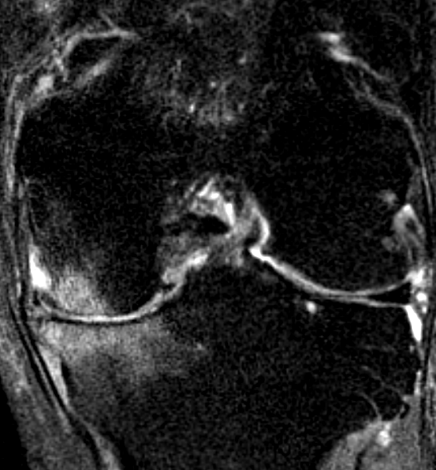
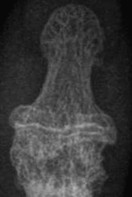
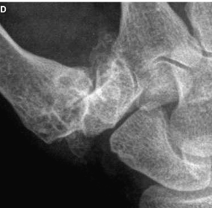
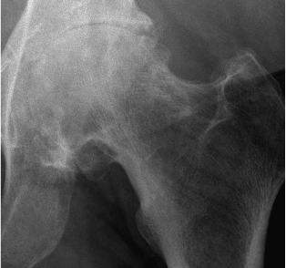
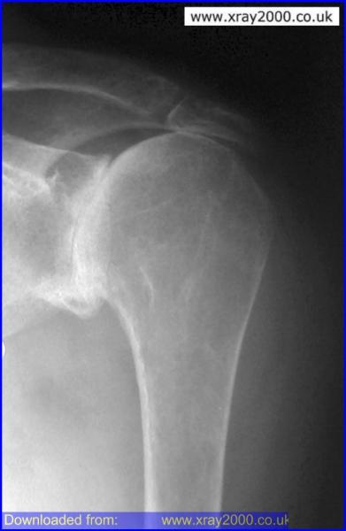
End-Stage OA: Joint Failure
Notes:
So finally, what is end-stage osteoarthritis? We can probably define it many ways. I recently asked one the surgeons I do research with how he would define end-stage knee OA and his response was that it comes down to the functional limitations for a particular patient. For example, being able to walk a few blocks might be important to one patient but not another.
While functional limitations and unmanageable pain may describe end-stage OA some also consider the end-stage based on complete loss of joint space but it remains unclear why some patients with complete loss of joint space continue to function sufficiently while other with relatively sufficient joint space cannot. This suggests that end-stage osteoarthritis may be individualized.

Slide 39
Summary: OA Onset & Progression
Macro & Micro Trauma
Subchondral & Articular Cartilage Remodeling
Altered Synovium
Biochemical Changes & Altered Gene Expression
Microscopic Structural Changes
(bone, cartilage)
Signs & Symptoms
Altered function & load
OA Diagnosis & Eventual Joint Failure
Macroscopic Structural Changes (visible on x-ray)
Cattano N et al. (Not Published)
Notes:
Before we conclude I would like to offer a visual explanation of how OA progresses.
We discussed in the beginning that a major traumatic event or repetitive overloading may trigger changes in the subchondral bone, articular cartilage, and synovium.
These changes are characterized by altered gene expression, biochemical, and microscopic structural changes.
These alterations propagate a complex vicious cycle in which repetitive loading, inflammation, and the changes in each tissue can influence changes throughout the joint.
Eventually these minor changes begin to manifest into structural changes we can see and signs and symptoms the patient reports.
Unless we find a way of breaking this cycle the joint will eventually fail.

Slide 40
So What?
OA is not a simple disease
OA has many causes
  Several pertinent to the sports medicine community
OA is a disease of the whole joint & person
Treatments may be more effective if initiated before a point of no return
Individualized approaches of management
We have a lot to learn
Notes:
So what? I hope by now that you can see that osteoarthritis is a complex disease with many potential causes; some of which are very pertinent to the sports medicine community.
Furthermore, once osteoarthritis begins it can influence the entire joint and the entire patient.
We still need to learn whether we need different treatments in early osteoarthritis versus later stages of osteoarthritis and if treatments should be initiated prior to a potential point of no return.
If this is the case, then for our patients we are uniquely positioned to intervene very early, for example, at the time of injury or surgery.
What the optimal treatment might be is still up in the air and based on the complexity of the disease and the potential for OA subtypes we must wonder if we’re going to need individualized approaches to manage osteoarthritis.
Finally, we have a lot to learn. This is an exciting time in osteoarthritis research and the sports medicine community is uniquely positioned to improve our understanding of early osteoarthritis and to test new treatments as they arise. In the future, it would not be surprising if the sports medicine community is not only striving to prevent acute and chronic injuries associated with participation in sports and other activities but also playing a key role in the prevention of chronic conditions like osteoarthritis.

Slide 41

Thank You!
Sometimes figuring out the pathways can be tricky.
Notes:
Thank you, thank you for your time.
25-26 minutes

Slide 42
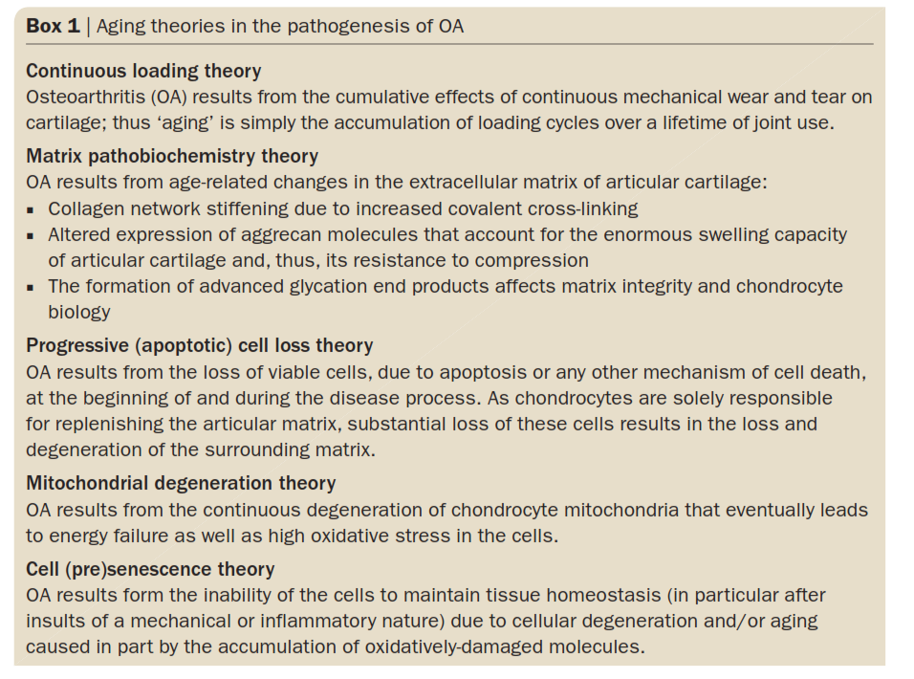
Aigner 2012

Slide 43
Local or Global Osteoarthritis
Some patients may exhibit a predisposition for global osteoarthritis
  Note framingham results/Ida’s hand data/Amanda’s race data
Some patients may only present with local (joint-specific) osteoarthritis
  E.g., post-traumatic osteoarthritis, abnormal hip shape

