Slide 1
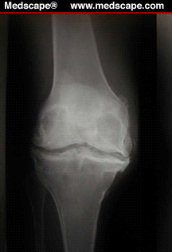

Basic Science Research: Where is the Clinical Relevance?
Biochemical and Imaging Markers in Knee OA
Jeffrey B. Driban, PhD, ATC, CSCS
Division of Rheumatology
Tufts Medical Center
June 27, 2012
Notes:
Good afternoon, it’s a pleasure to be here to discuss the clinical relevance of biochemical and imaging markers in knee osteoarthritis. Steve just explained how animal models can have an impact on the clinical setting.
But, while we have numerous animal models for joint degeneration that have helped us understand osteoarthritis we have been unable to translate animal research to successful treatments for humans.
Our incomplete understanding of how to optimally use animal models in osteoarthritis has led many researchers to be more dependent on imaging and biochemical measures in humans to help us study osteoarthritis and identify new potential candidate treatments.

Slide 2
Overview
Overall Goal: To educate athletic training clinicians and researchers about the clinical relevance of basic science and how it can be used to answer clinically driven questions.
Specific Goal: To explain the application and interpretation of biochemical biomarkers and imaging markers in the knee joints of humans.
Notes:
So, within the overall objective for this session I’d like to discuss some of the more common biochemical biomarkers and imaging markers that are available, as well as describe what they can tell us about osteoarthritis.
While some of these measurements, particularly imaging outcomes, might not seem like basic science they are starting to help us understand how OA develops and progresses.
In fact, I‘ll discuss some of the current imaging techniques that are allowing us to explore outcomes that have traditionally been limited to research on animals, cadavers, or excised tissues.

Slide 3
Definitions
Biomarkers
  Objective
  Cellular, biochemical, or molecular (including genetic and epigenetic) measure
  Collected in biological materials (e.g., tissues, bodily fluids)
  Can detect normal or pathologic processes
  Imaging markers do not fulfill the classic definition
Bauer DC 2006
Notes:
Before we get to far I’d like to start off by carefully defining the term biomarkers. Biomarkers are typically objective cellular, biochemical, or molecular measurements of biologic specimens that can be used to detect normal or pathologic processes.
It is interesting to note that imaging markers, despite sometimes providing an apparent measure of molecular changes, do not fulfill the classic definition of a biomarker.

Slide 4
Definitions
“BIPEDS” classification system
  Burden of disease
  Investigative
  Prognostic
  Efficacy of Intervention
  Diagnostic
  Safety of Intervention
Bauer DC et al., 2006; Kraus VB et al. 2011 (OARSI-FDA Initiative; Biomarkers Working Group)
Notes:
In 2006, the NIH-funded OA Biomarkers Networks proposed the “BIPED” classification system for OA biomarkers.
The system indicates that a biomarker may be classified in several categories: burden of disease, investigative, prognostic, efficacy of intervention, and diagnostic. This classification system was recently expanded to include safety of intervention biomarkers.

Slide 5
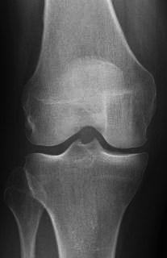
Definitions
“BIPEDS” classification system
  Diagnostic
  Burden of disease
  Prognostic
Bauer DC et al., 2006; Kraus VB et al. 2011 (OARSI-FDA Initiative; Biomarkers Working Group)
Notes:
Lets take a closer look at these classifications which may help us conceptualize how biomarkers may play a role in the clinical setting and in clinical trials. For example,
Diagnostic biomarkers are markers that can differentiate whether an individual has disease, or a specific subtype or phenotype, but may not be able to differentiate between disease severity.
Instead a biomarker which can define the severity or staging of a disease would be considered a burden of disease biomarker.
So for example, a biochemical marker that can differentiate between those with and without OA would be considered a diagnostic biomarker but it will only be considered a burden of disease biomarker if it can also differentiate between early- and later-stages of osteoarthritis.
Another useful set of biomarkers would be the Prognostic biomarkers which can predict incident disease, disease progression, or represents an early response to an intervention that is reflective of a later clinical response. These biomarkers may be very valuable for identifying patients at risk for rapid disease progression or patients likely to respond to a treatment.

Slide 6


Definitions
“BIPEDS” classification system
  Efficacy of Intervention
  Safety of Intervention
Bauer DC et al., 2006; Kraus VB et al. 2011 (OARSI-FDA Initiative; Biomarkers Working Group)
Notes:
In regards to clinical trials there are two other BIPEDS classifications that may be particularly relevant.
For example, Efficacy of intervention biomarkers can range from markers of whether a compound is influencing the desired physiologic pathway or they may include surrogate markers that indicate whether the intervention is influencing disease progression.
Secondly, Safety of intervention biomarkers can be used to detect toxicity and may represent an important set of biomarkers in preclinical and clinical studies to monitor the health of joint tissues, the rest of the musculoskeletal system, or other organ systems. These biomarkers may include measures of toxicity or increased cartilage degradation.

Slide 7

Definitions
“BIPEDS” classification system
  Investigative
Bauer DC et al., 2006; Kraus VB et al. 2011 (OARSI-FDA Initiative; Biomarkers Working Group)
Notes:
Finally, we have Investigative biomarkers which are biomarkers that require further research because they do not have enough evidence to be classified in another BIPEDS category but show potential promise.

Slide 8
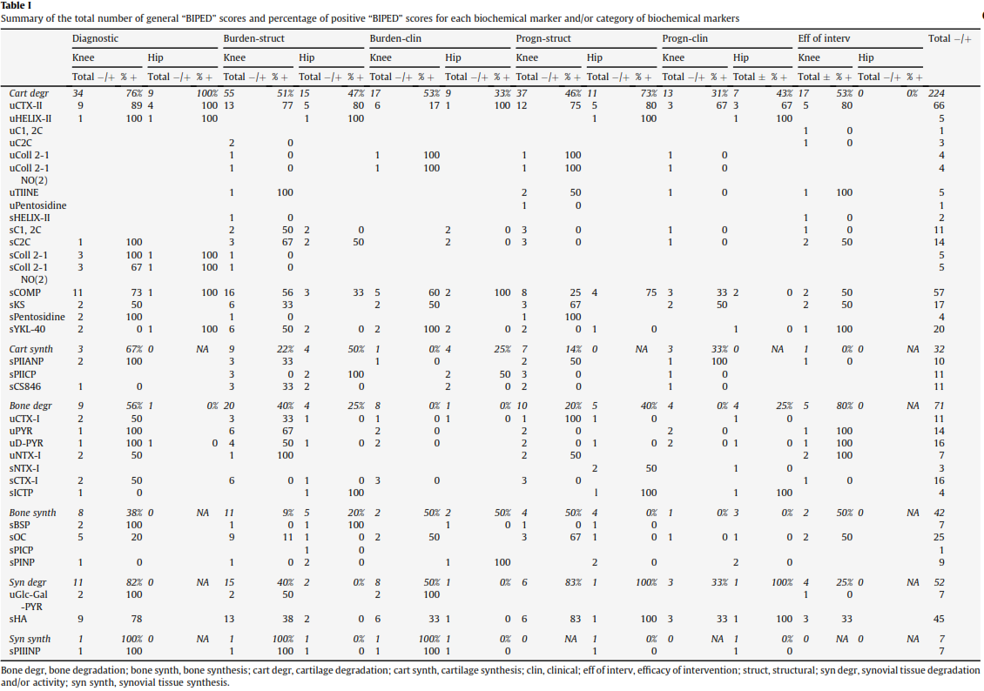
OA Biochemical Biomarkers
Spil van WE et al., 2010
Notes:
Now that we have differentiated between biomarkers and imaging markers and discussed ways of classifying biomarkers (and possibly other types of outcome measures) lets take a closer look at biochemical markers.
Now please, don’t try to read this table. I’m just using it to demonstrate that there is a wide range of potential serum and urinary biomarkers but many of them have not been well validated.
This list includes measures of degeneration and synthesis of the three major tissues we commonly associate with OA, which are cartilage, bone, and synovium.
5 minutes at most to this point

Slide 9
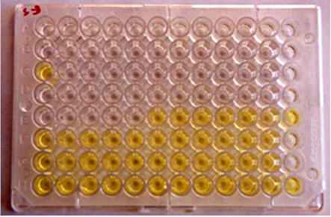
OARSI-FDA Initiative
OA Biomarkers Working Group Recommended Panel (2011)
  Identified 12 biomarkers
  Urine and/or serum (whole body burden)
  Excluded cytokines/chemokines
Kraus VB et al 2011 Image: http://agri.nv.gov
Notes:
One helpful resource for OA biochemical markers is the OARSI-FDA Initiative’s Biomarkers Working Group recommendations which included 12 biomarkers based on human studies of hip and knee osteoarthritis.
The working group focused on urine and serum measurements which may be more reflective of the whole body burden of osteoarthritis versus joint-specific changes.
For more joint-specific changes, synovial fluid analyses may be more appropriate but these were only briefly noted in the working group’s recommendations.
Furthermore, the working group excluded cytokines and chemokines, which may be valuable biomarkers of cell signaling associated with OA.
Despite these limitations, the recommendations can be helpful for assessing where we are at with osteoarthritis biomarkers.

Slide 10
Recommended Biomarker Panel
4 biomarkers of type I and II collagen degradation
2 biomarkers of type II collagen synthesis
2 biomarkers of bone resorption
Cartilage degeneration (serum cartilage oligomeric matrix protein; COMP)
Catabolic enzymes (serum matrix metalloproteinase-3; MMP-3)
Serum hyaluronan (reflective of osteophytes and synovitis)
Cartilage aggrecan turnover (serum aggrecan chondroitin sulfate 846 epitope)
Kraus VB et al 2011
Notes:
I’m not going to discuss the specific outcome measures included in the recommended panel but I think it’s important to note that the working group recommended a panel that assesses various aspects of osteoarthritis; including tissue synthesis and degeneration from various tissues.

Slide 11
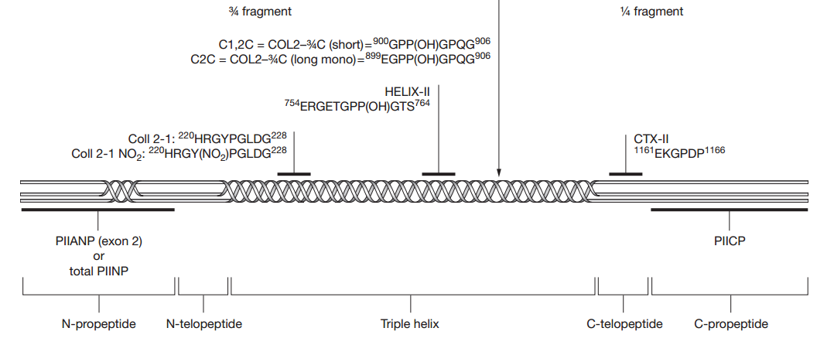
Recommended Biomarker Panel
Only two of the 12 biomarkers are classified as valid biomarkers:
  Urinary C-terminal cross-linking telopeptide of type II collagen (CTX-II)
    From mineralized and nonmineralized cartilage as well as bone
    Associated with type II collagen degradation and osteophytes
    Burden of disease (knee and hip)
    Prognostic (knee and hip)
    Efficacy of intervention (knee only)
    Diagnostic biomarker (knee and hip)
Image: Rousseau J &
Delmas P 2007
Notes:
Unfortunately, only two of the 12 biomarkers were recognized by the working group as being valid. The first is urinary CTX-2 which is from mineralized and nonmineralized cartilage as well as bone. CTX-2 is associated with type II collagen degradation, cartilage ossification, as well as osteophytes. Based on the BIPEDS classifications, the working group felt that urinary CTX-II could be classified as a burden of disease, prognostic, efficacy of intervention, and diagnostic biomarker for hip and knee OA.
Figure 1 Schematic localization of epitopes in type II procollagen. Amino acid numbering and sequence data are taken from SwissProt accession number P02458. Initial cleavage of procollagen by collagenases generates two fragments that are, respectively, ¾ and ¼ the size of the procollagen molecule. The C-terminal neoepitope of the ¾ fragment can be detected by two assays: the COL2–¾C (short) antibody used in the C1,2C assay recognizes type I and type II collagen on the basis of sequence homology; and the COL2–¾C (long mono) antibody used in the C2C assay recognizes type II collagen only. Two assays recognize a peptide of nine amino acids (Coll 2-1) or its nitrated form (Coll 2-1 NO2). The HELIX-II assay recognizes a neoepitope specific to type II collagen. In the C-telopeptide, the CTX-II assay recognizes a peptide of six amino acids. Type II collagen is synthesized as a procollagen molecule, with N-propeptides and C-propeptides at each end. It is produced in two isoforms by alternative RNA splicing. One form (PIIANP) includes, and the other form (PIINP) excludes, a 69-amino-acid globular domain in the N-propeptide that is encoded by exon 2. During synthesis, these propeptides are removed by specific proteases before the mature molecules are incorporated into fibrils. The C-propeptide can be detected by a PIICP assay. Two assays that recognize PIIANP and total PIINP, respectively, have been developed. Abbreviations: CTX-II, C-terminal cross-linked telopeptide of type II collagen; HELIX-II, helical type II collagen; PIIANP, collagen type IIA N-propeptide; PIINP, collagen type II N-propeptide; PIICP, procollagen type II C-terminal propeptide.

Slide 12
Recommended Biomarker Panel
Only two of the 12 biomarkers are classified as valid biomarkers:
  Serum matrix metalloproteinase (MMP)-3
    Enzyme associated with joint tissue degradation and inflammation
    Intervention efficacy for knee OA
Notes:
The second valid biomarker is serum matrix metalloproteinase-3, which is an enzyme associated with joint tissue degradation and inflammation.
MMP-3 was classified as a valid marker of intervention efficacy for knee OA.
These recommendations highlight the amount of research that is still needed to validate OA biochemical biomarkers for knee and hip osteoarthritis let alone other joints.

Slide 13
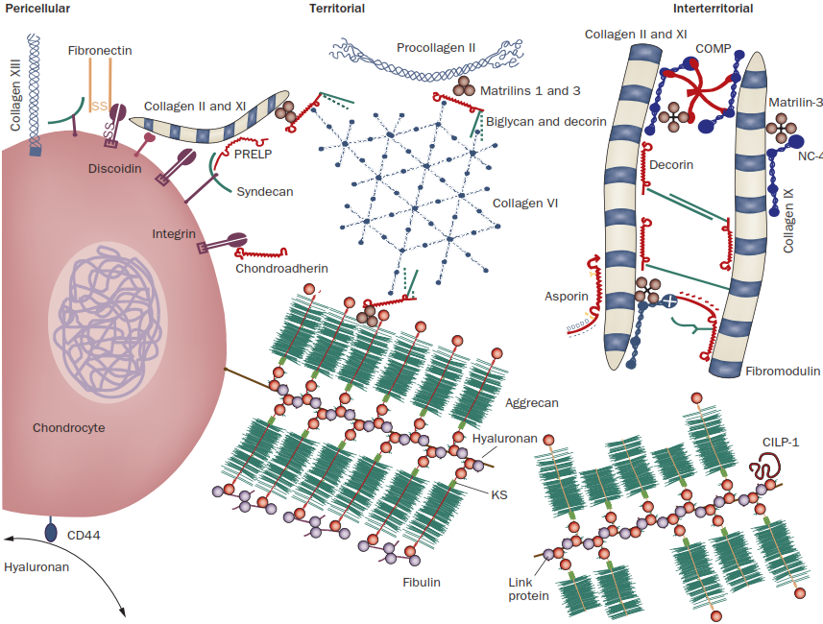
OA Biomarkers
Serum COMP
  Diagnostic
    Possibly a moderate difference between knees with and without osteoarthritis
    This pattern was detected across radiographic severities
    More prospective studies will be needed
Spil van WE et al., 2010, Hoch JM et al., 2011
Image: Heinegard D & Saxne T 2010
Notes:
While the working group recognized two biomarkers as being validated I think there is a third that is likely to gain status as a valid diagnostic biomarker and that would be serum COMP, which is a noncollagen biomarker of cartilage degradation present in articular cartilage and other soft tissues.
Two recent systematic reviews demonstrate that there is preliminary evidence that serum COMP could be a potential valid diagnostic marker for knee osteoarthritis but more research will be needed to confirm this status.

Slide 14
Misfit Island
Cytokines, chemokines, neuropeptides, etc
  These key signaling proteins are often omitted from discussions about OA biomarkers
  Can be very valuable when assessing questions regarding mechanisms and pathways
  BUT
  Require more validation
Notes:
As I noted earlier, the working group omitted cytokines, chemokines, neuropeptides, and many other types of proteins that may be relevant to osteoarthritis.
While these biomarkers are often omitted from discussion as OA biomarkers they warrant more attention.
These biomarkers can be valuable when assessing questions regarding mechanisms and pathways related to osteoarthritis and interventions.
But it is important to note that within the BIPEDS classifications these biomarkers require more validation.

Slide 15
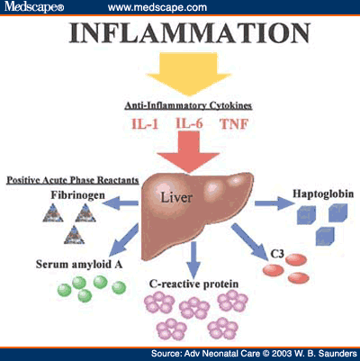
Inflammatory Biomarkers
Serum high-sensitivity C-reactive protein
  Associated with knee
  symptoms and
  change in knee symptoms²
  Probably not associated
  with radiographic OA¹
    Hand, knee, and hip
1. Kerkhof H et al., 2010; Vlad SC et al., 2011. 2. Stannus O et al. 2012, Stürmer T et al. 2004
Notes:
Despite the lack of data, biomarkers that assess inflammation may provide important insights.
One good example is c-reactive protein, or CRP, which is an acute phase protein produced by the liver and is a biomarker of systemic inflammation.
When measured with high sensitivity assays, serum CRP levels are associated with joint symptom severity and changes in joint symptoms but not radiographic severity.
If additional studies can verify these findings then this would indicate inflammatory biomarkers may warrant BIPEDS classification.

Slide 16
Things to Consider
Systemic biomarkers reflect OA of the patient
Intra-articular biomarkers characterize local OA
  Can be done in noneffused knees¹
Depending on the purpose of analyses or intervention it may be preferable to select systemic or local biomarkers.
1. Cattano N et al. 2011;Driban JB et al. 2010; Kraus VB et al. 2007
Notes:
So far we’ve discussed how the OARSI-FDA Initiative’s Biomarkers Working Group recommended a diverse panel of OA biomarkers to assess synthesis and degeneration of various tissues and that other biomarkers, for example inflammatory biomarkers, may have clinical utility in assessing disease status, prognosis, and response to treatments. I think it is important to keep in mind that most of the biomarkers we’ve discussed so far have been from the serum or urine which means that while they may relate to disease severity of a specific joint there is always the potential for other joints to be contributing to the serum or urine concentrations.
If we want a truly local assessment then measuring the biomarkers from intra-articular sources, like synovial fluid, may be the optimal approach. Historically, it has been a challenge to collect synovial fluid samples from noneffused joints but over the past few years the group I’ve work with at Temple University and Dr. Kraus’ group at Duke University have demonstrated the feasibility of saline-assisted aspirations. At the end of the day, the clinician and researcher will need to make the decision about whether they are interested in systemic measures or local measures of OA.
For example, it may be ideal to assess local biomarkers in a clinical trial for intra-articular injections. While in contrast, if we are testing a systemic intervention, like an oral NSAID, then we may want to evaluate the whole-body burden of OA in which case systemic markers may be more appropriate.

Slide 17
Where is the Clinical Relevance?
We’ve only seen hints of the potential for biomarkers
  BIPEDS
  Better defining osteoarthritis and phenotypes
  Influence on drug development
Notes:
So, I think we may still be wondering about the main goal of this session…where’s the clinical relevance?
I think the BIPEDS classification highlights one aspect of how these biomarkers will influence clinical practice. Imagine a scenario, where one of our patients that suffered an ACL injury comes in for re-evaluation and the physician orders an OA biomarker panel to determine if the patient has developed pre-radiographic osteoarthritis, whether they are at risk for rapidly progressing over the next few years, and if so, which treatment might they respond best to. Is this science fantasy, perhaps, but it is reasonable to think that this could be in our future.
But in the present day, these biomarkers are helping us better understand osteoarthritis. For example, it is increasingly being recognized that low-grade inflammation is common in osteoarthritis and there may be phenotypes or subsets where inflammation is more relevant. Finally, the biomarkers that are altered in OA may signal potential therapeutic targets. Overall, I think OA biomarker research holds a lot of potential and remains understudied; although this is starting to change.

Slide 18
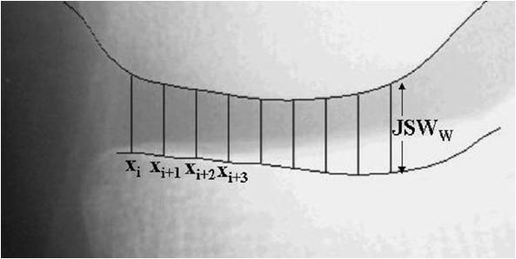
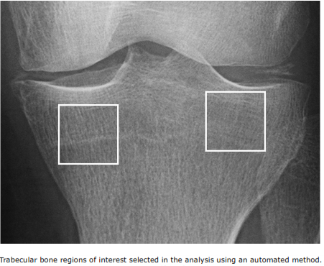
Imaging Markers
Radiographs
  Semi-quantitative scoring
  Quantitative joint space width
  Fractal signature analysis (FSA)
Recommended Reference for Imaging Markers: OARSI Primer (http://primer.oarsi.org)
Notes:
Now we’ve been discussing OA biomarkers thus far, but by far, imaging outcomes remain the dominant method of assessing osteoarthritis and so next I’d like to discuss some of the more common imaging outcomes that are available and how they may be clinically relevant.
For example, radiographs remain the gold-standard for assessing osteoarthritis and typically involve semi-quantitative scoring, quantitative joint space width assessments, and fractal signature analyses.
13- min

Slide 19
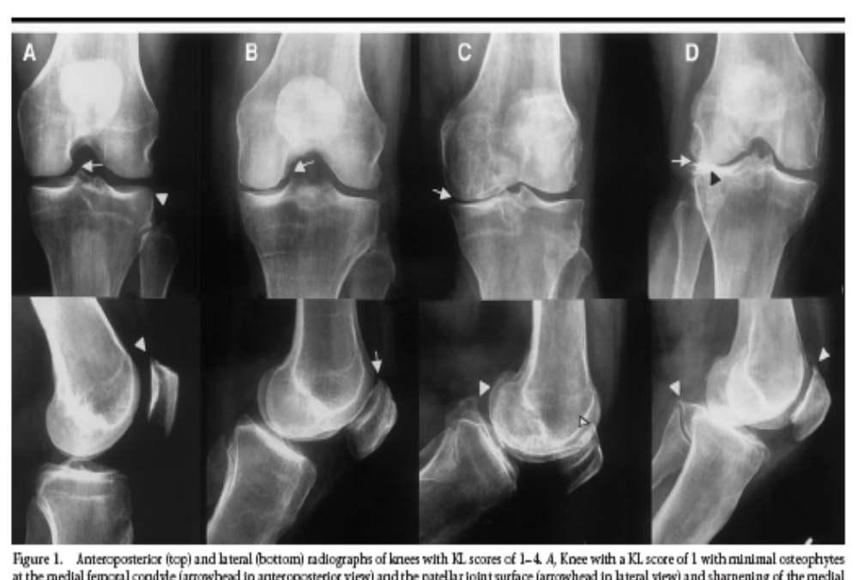
Semi-quantitative Scoring
Whole Joint Scores
  E.g., Kellgren-Lawrence Scoring System (0-4)¹
OARSI Scores²
  Can be used to assess JSN, osteophytes, etc
Modified OARSI Scores³
  Added within grade changes
1. Kellgren & Lawrence 1957, Schophof et al., 2008; 2. Altman & Gold 2007; 3. Felson et al., 2008
Notes:
For semiquantitative outcomes, one of the most established is the Kellgren-Lawrence scoring system which has been around since the 1950s and defines radiographic severity based on osteophytes, joint space narrowing, sclerosis, and sometimes bone shape deformities. While this is a convenient whole joint assessment it doesn’t address individual features of OA.
To address individual radiographic features it can be helpful to use the OARSI atlas, for which the latest version was released in 2007. The OARSI atlas provides a method to separately assess features like joint space narrowing or osteophytes. While this is a commonly used method to assess specific types of structural changes, Felson et al recently proposed within grade changes and this scoring approach has been adopted by two large cohort studies.
All of these methods offer convenient assessments of radiographic severity but they may be susceptible to misclassification between scores and not as sensitive to change as quantitative assessments.

Slide 20
Quantitative Joint Space Width
Well validated
Provides a continuous outcome for joint space narrowing
Available for the knee, hip, and hand
Knee: Duryea J et al., 2003; Lynch JA et al., 1993
Notes:
As an alternative to the traditional semiquantitative methods of assessing radiographic severity some people opt to measure the joint space width at the narrowest region of the joint space or at fixed locations across the joint.
These methods offer a more sensitive assessment of joint space change compared to semiquantitative scoring but may be more prone to measurement error.
Therefore, a lingering question is whether one method is truly superior to the other.

Slide 21
Clinical Implications
Joint space narrowing remains the primary outcome for clinical trials
However, these measures may not be optimal for monitoring progression in early OA
FDA – Guidance for Industry (Draft Guidance) 1999
Notes:
While we are about to discuss an array of other imaging outcomes it is important to note that joint space narrowing remains the primary outcome for clinical trials according to the FDA.
Furthermore, radiographic assessments remain the clinical standard.
However, particularly in the sports medicine population, these outcomes may not be optimal because there may be significant changes occurring in the joint before radiographic evidence emerges.
In this respect, there are other outcome measures that may have the potential to monitor early structural changes, provide important insights into osteoarthritis, become an FDA recommended outcome measure, or appear in the clinical setting.

Slide 22
Fractal Signature Analysis
An apparent measure of trabecular morphometry
Sensitive to early changes in subchondral bone
Possibly predictive of joint space narrowing
Buckland-Wright JC et al., 1996; Kraus V et al., 2009; Woloszynski T et al. 2011
Notes:
One of these outcomes that might be sensitive to early changes in osteoarthritis is fractal signal analysis of radiographs.
Fractal signature analysis measures the texture of bone, which might represent changes in the bone’s trabecular structure but more research is needed to verify this hypothesis.
Regardless, it has been suggested that fractal signature analysis may predict joint space narrowing among knees with and without radiographic osteoarthritis.
If these findings hold up then this could be a cost-effective method of evaluating early OA and the risk of OA progression.

Slide 23
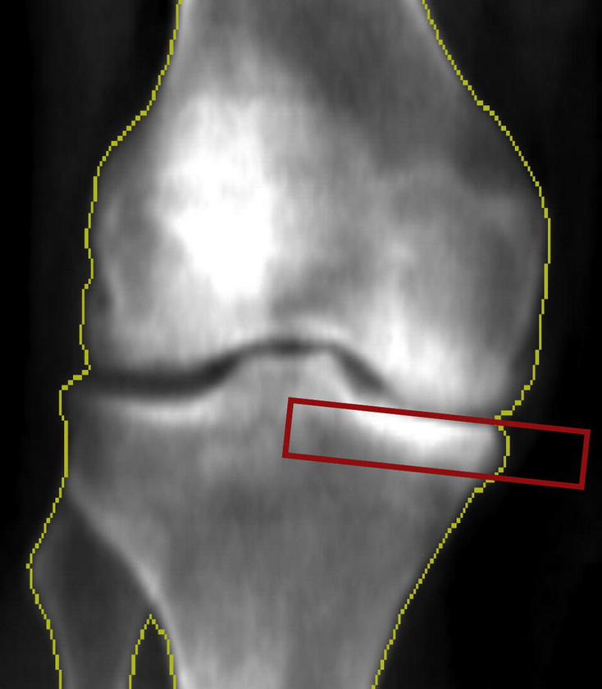
Peri-articular DEXA
Dual Energy X-ray Absorptiometry
  Cost-effective
  Related to joint space narrowing
  Maybe related to progression
Lo GH et al. 2006, 2012, 2012 (OARSI Abstract)
Notes:
Similar to fractal signature analysis of radiographs, analyses of bone mineral density from knee DEXA scans may be a cost effective method of assessing knee osteoarthritis.
When bone mineral density is examined as a ratio of medial-versus-lateral proximal tibia it is associated with radiographic disease severity and may predict disease progression.

Slide 24
Magnetic Resonance (MR) Imaging
Structural Assessment (macro)
  Cartilage morphometry
  Bone marrow lesion (BMLs)/subchondral cysts
  Meniscal morphometry
  Effusion/Synovitis
  May include…
    Quantitative assessments
    Semiquantitative scores (e.g., BLOKS, WORMS, MOAKS)
Notes:
While radiographs and DEXA scans may be imaging outcomes that can be easily deployed in the clinical setting, MRI has been embraced in osteoarthritis research and has influenced our understanding of osteoarthritis and many MR-based outcomes may eventually be included as an accepted outcome for clinical trials. In fact, several clinical trials are already assessing the influence of interventions on MRI measured cartilage and bone changes.
When we discuss MRI-based outcomes its important to keep in mind that we have assessments of macroscopic changes, for example, cartilage loss or meniscal damage; and microscopic outcomes, for example, changes in cartilage composition. I’ll start by briefly discussing the assessments of macroscopic changes.

Slide 25
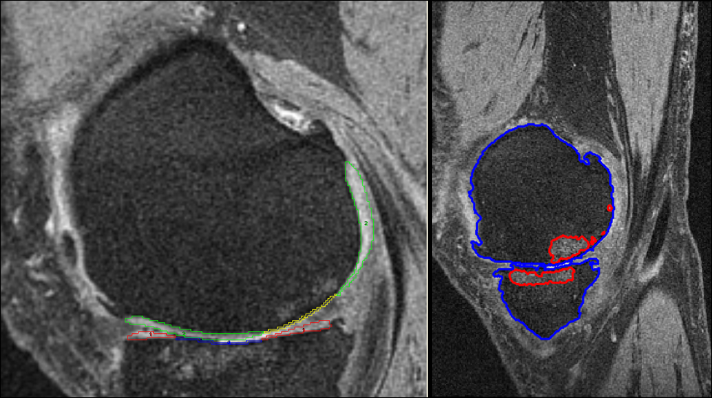
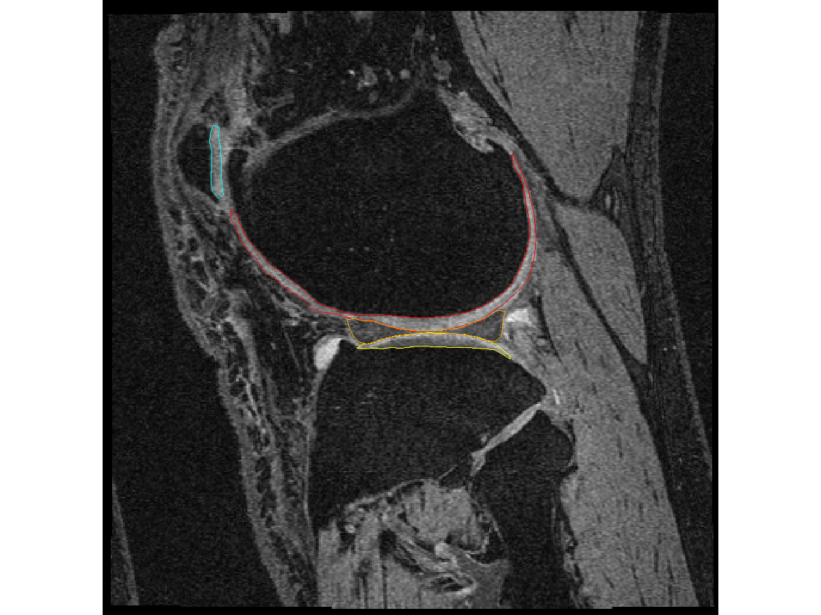
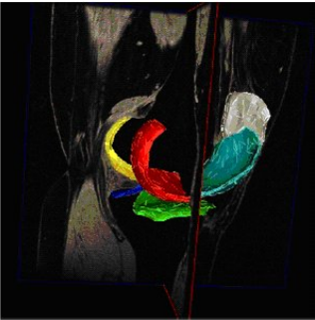
Cartilage Morphometry
Description of Nomenclature: Eckstein F et al., 2006;
OARSI-FDA OA Assessment of Structural Changes Working Group: Conaghan PG et al., 2011
Bottom right image: http://oai.epi-ucsf.org/datarelease/SASDocs/kMRI_QCart_Eckstein_Descrip.pdf
Notes:
Over the past few years, a wealth of articles have been published with MR-based cartilage changes.
Using these quantitative or semiquantitative assessments we can assess changes in cartilage thickness as well as changes in full thickness cartilage lesions.
By focusing on just cartilage we’ve improved our understanding of how the cartilage changes in humans over time, for example, the cartilage doesn’t just thin, it can also swell or thicken.
It has also enabled us to see how the joint tissues interact. For example, using MRIs we can assess how meniscal damage or bone changes might influence cartilage and vice versa.
Last year, the OARSI-FDA OA Assessment of Structural Change Working Group suggested that MRI should be recommended for clinical trials in terms of assessing cartilage morphology.

Slide 26
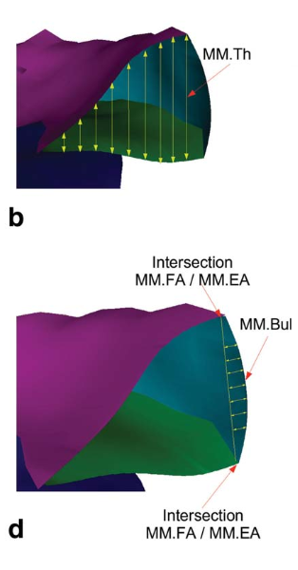
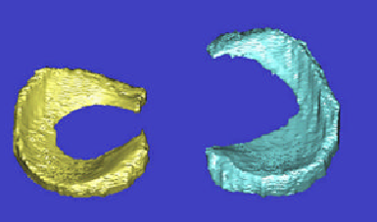
Meniscal Morphometry
Image (bottom left): Bowers ME et al., 2007
Image (right): Wirth W et al., 2010
Notes:
One catalyst for cartilage change may be meniscal damage.
Interestingly, it was recently reported that 61% of adults 50 to 90 years of age had meniscal tears in their knees but no symptoms in the month prior to the MRI.
Traditionally meniscal pathology has been described based on the type of pathology (for example a radial tear) or with semi-quantitative scores, however, more recently, researchers have begun to segment menisci and provide quantitative assessments of meniscal size, shape, and location.
Assessing meniscal integrity has improved our understanding of how meniscal pathology may promote structural changes in the cartilage and bone.

Slide 27
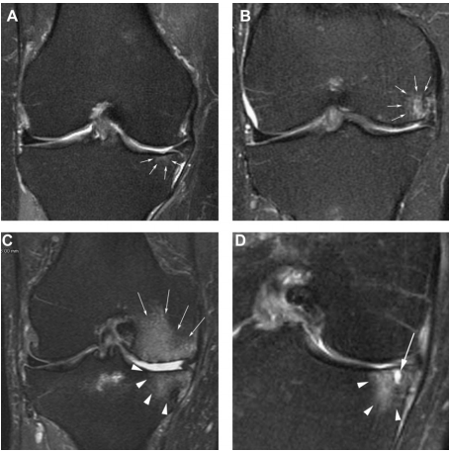
BML Morphometry
MOAKS
Grade 1
MOAKS
Grade 2
MOAKS
Grade 3
Left image: Hunter et al., 2011
Notes:
While assessing cartilage and meniscal changes has improved our understanding of OA so has MRI-based measurements of bone. In particular, bone marrow lesions, are common pathologic MRI findings among knees with osteoarthritis.
Bone marrow lesions, or BMLs, are particularly interesting because they are transient and seem to be related to risk factors that increase local loading on bone; for example, knee malalignment and meniscal injuries.
But BMLs are also related to cartilage loss and joint symptoms and recent findings by Dr. Frobell was that within the first 2 years after an ACL injury many patients begin to have BMLs.
It’s possible that BMLs could be a sign that the joint is being overstressed and at risk for progressive structural changes.

Slide 28
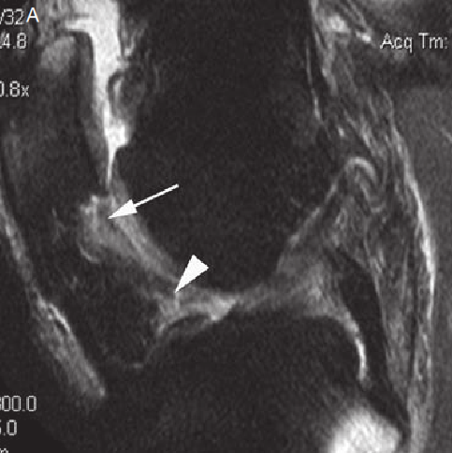
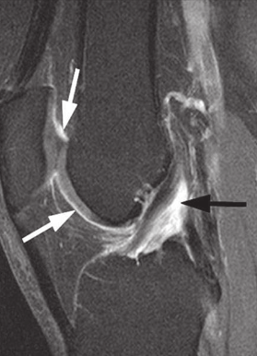
Synovitis/Effusion
Providing new insight about the role of synovitis in OA progression (structural and symptomatic).
Noncontrast-enhanced
MR Image
Contrast-enhanced
MR Image
Lo GH et al., 2009; Roemer FW et al ., 2011 (noncontrast-enhanced image);
Contrast-enhanced MR Image: Guermazi et al., 2011
Notes:
Similar to BMLs, synovitis or effusion can be transient and relates to symptoms as well as structural progression.
As you can tell from the past few slides, MRI has allowed us to gain a better understanding of how each tissue contributes to OA.
Hopefully, over the next few years these imaging outcomes will be applied to younger populations to help us understand the early phases of osteoarthritis and what differentiates those on a path to early- vs late-onset osteoarthritis.

Slide 29
Magnetic Resonance (MR) Imaging
Structural Assessments (micro)
  Cartilage Composition
    T1 rho
    T2
    dGEMRIC
  Meniscal Integrity
  MR Spectrometry
  Trabecular Morphology
Notes:
While the structural changes detected on the previous MRI sequences may allow us to assess pre-radiologic osteoarthritis there are new techniques that may allow us to detect structural changes even earlier and potentially improve our understanding of how knee structures adapt to loading.
Over the past few years MRIs have begun to open up opportunities that were previously limited to animal models and excised tissue.

Slide 30
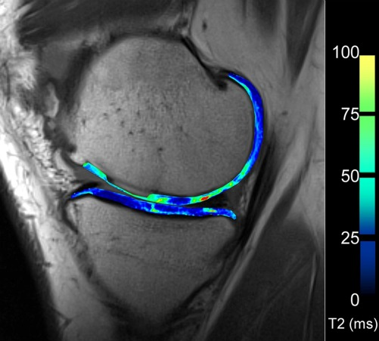
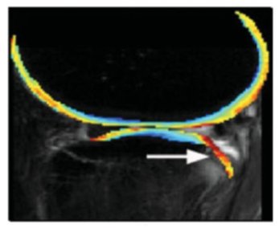
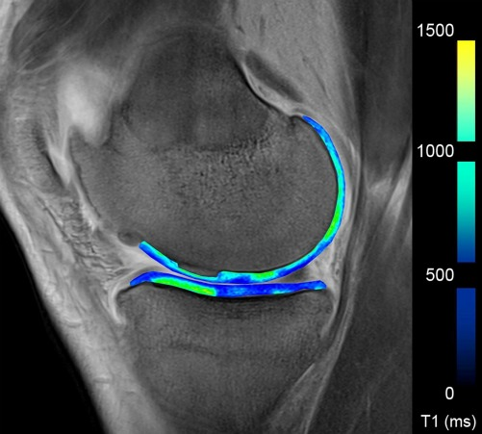
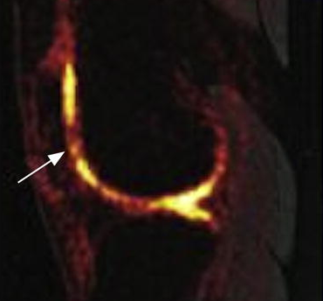
Cartilage Composition
T2 Mapping
T1rho Mapping
Image: Li X et al., 2008
dGEMRIC (contrast)
Na+ MR Imaging
Image: Choi & Gold 2012
Images: Roemer et al 2011 (OARSI Primer)
Notes:
There are several examples of MR sequences that enable us to assess the composition of the extracellular matrix of the articular cartilage.
These sequences are verifying findings we’ve seen in animal models.
For example in the dGEMRIC image we can see altered extracellular matrix in the superficial layer, indicated by the darker blue, that is preceding dramatic macroscopic changes.
These techniques have also been used to evaluate how the cartilage responds to an acute bout of running as well as to running over time.
For example, marathon-length runs may induce signal changes associated with adverse changes to the cartilage matrix but a gradual 10-week running program may promote beneficial changes to the cartilage composition. It should be noted, however, that these studies typically have a small sample size.
T2 (H20 content &collagen degradation; changes in collagen matrix orientation) high= bad
dGEMRIC (proteoglycan content, organization) low = bad
T1 rho (detects water, damage to cartilage collagen-proteoglycan matrix; changes in proteoglycan content) high = bad
UTE-T2* (collagen matrix)
Luke AC 2010 (marathon) and Van Ginckel 2010 (10-week running)

Slide 31
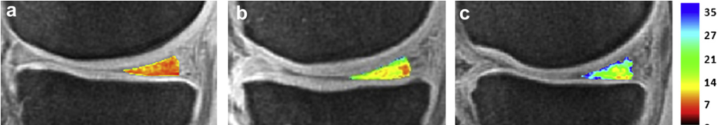
Application to Other Tissues
Ultrashort echo time-enhanced T2*
  Collagen disorganization
Asymptomatic ACL Patient san Meniscal Tear ACL patient with Meniscal Tear
Image: William A et al., 2012
Notes:
Similar to assessing cartilage composition we’re also able to use MRI to assess the structural integrity of menisci.
These techniques are capable of detecting altered menisci even in the absence of other meniscal findings.
These MRI techniques are enabling us to assess longitudinal histopathologic changes in the human knee joint which is especially valuable since our knees have unique biomechanics because of our bipedal gait.
Figure: Sample UTE-T2*maps of histologically and clinically conﬁrmed tears to the posterior horn of the medial meniscus. UTE-T2* maps demonstrate focal regions (red arrows) of relatively high UTE-T2* values in (a) a 77-year-old male with a posterior tear extending to the body junction, mean SD UTE-T2* across entire ROI ¼ 8 3 ms, and in (b) another 77year-old male with a complex posterior tear, mean SD UTE-T2* =10 +/- 3 ms. Corresponding Saf-O images of these specimens (c, d) verify tears to the menisci (black arrows) and
show moderate GAG staining. The saturation and contrast of these Saf-O images have been manipulated to more clearly demonstrate tissue morphology.
Example UTE-T2* maps (aec) overlaid on AWSOS images acquired with UTE ¼ 0.6 ms demonstrate striking UTE-T2* differences between subjects. UTE-T2* values (mean SD) of an asymptomatic subject are lower and more homogeneous (a, 8 2 ms) than observed in a patient without (b, 13 5 ms) or in a patient with tear to the medial meniscus (c, 21 7 ms). UTE-T2* values of the posterior meniscus varied signiﬁcantly across subjects with degree of joint pathology (d, medial P < 0.0001; e, lateral P ¼ 0.001).

Slide 32
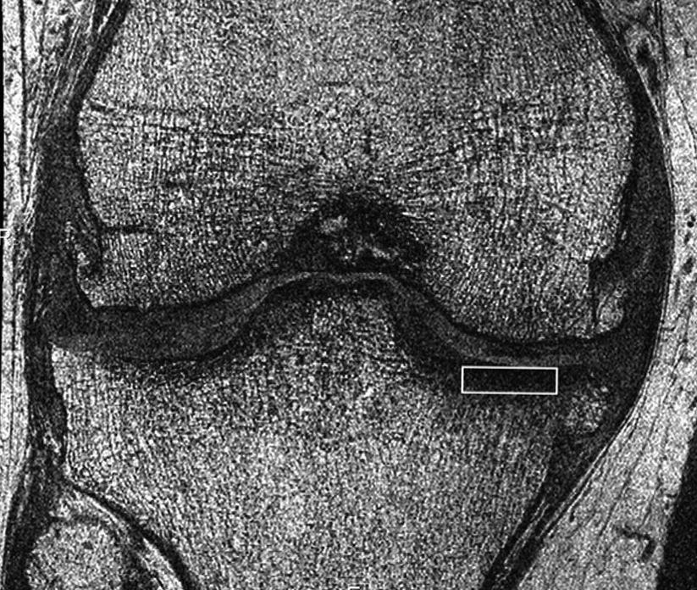
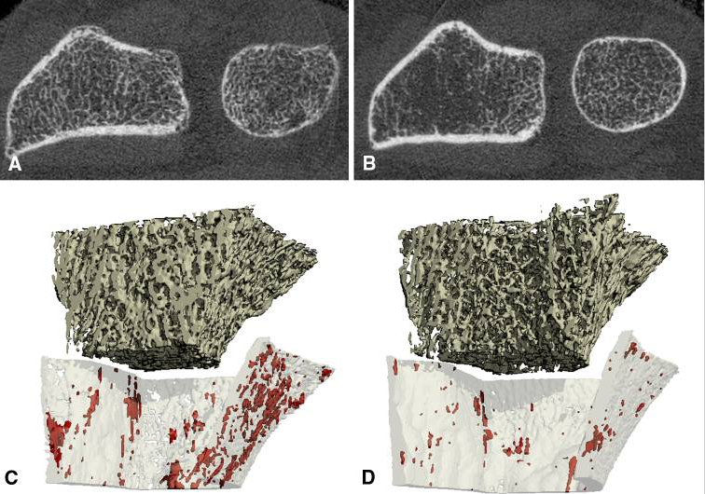
Trabecular Morphometry
3D FISP – High-Resolution
High-Resolution MRI Peripheral CT Scans
Lo GH et al. 2012; Schneider E et al., 2011 Burghardt AJ et al 2011
Notes:
Besides looking at soft tissue, high resolution MR images and peripheral CT scans are also beginning to provide new insights into trabecular bone changes.
These imaging techniques are beginning to allow us to study how the microarchitecture of bone is adapting to disease.
For example, Lo et al recently demonstrated that trabecular bone changes in the proximal tibia are related to radiographic severity and at the most recent OARSI conference she presented data that indicated these trabecular measures may predict radiographic disease progression.

Slide 33
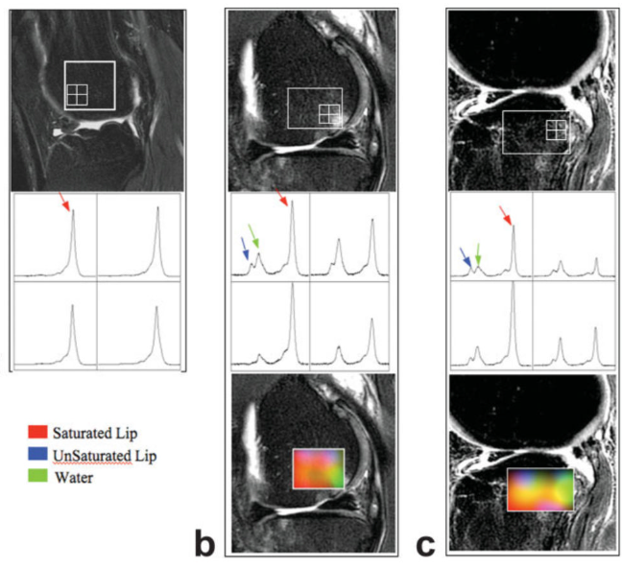
MR Spectrometry
Noninvasive method to quantify biochemical/ metabolic changes
Li X et al., 2008
Notes:
Taking the microscopic changes a step forward is the use of MR spectrometry which provides a noninvasive method for quantifying biochemical or metabolic changes in tissues.
For example in these images, Li et al found that bone marrow may have different amounts of saturated and unsaturated lipids and water content when a patient has knee OA and/or a BML compared to a healthy knee.
These new techniques may never make it to a clinical setting but even if they don’t their ability to provide in vivo human measurements of histopathologic changes could help us understand what places patients at risk for developing OA and/or help us develop new clinical interventions.
Figure: Significantly elevated water and unsaturated lipids, and decreased saturated lipids were observed in BMEL. The volume of elevated water correlated with the volume of BMEL. Water content was significantly higher within BMEL than that outside BMEL. The unsaturation index outside BMEL was significantly higher in patients with ACL tears than that in OA.

Slide 34
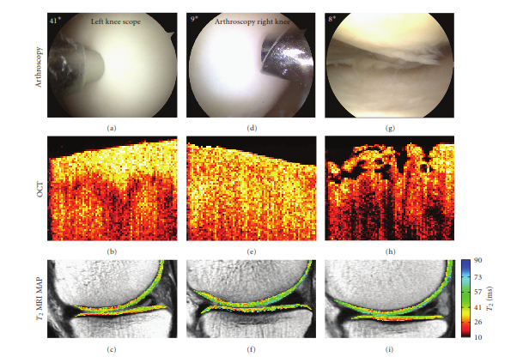
Arthroscopic Optical Coherence Tomography
Based on infrared light
Cross-sectional images on par with low-power histology
O’Malley MJ &
Chu CR 2011
Notes:
While some of the MRI sequences for looking at cartilage histopathology might not be available to clinicians there is an interesting approach called arthroscopic optical coherence tomography that may eventually make its way into operating rooms.
Optical coherence tomography is a nondestructive imaging technology based on infrared light that generates a cross-sectional image of articular cartilage that is on par with low-power histology.
Intra-operative assessment of articular cartilage is not new but applying optical coherence tomography could allow surgeons to better assess the structural integrity of articular cartilage.
This could lead to early diagnosis of osteoarthritis when a patient is undergoing surgery for an injured ACL or meniscus.
Figure: a-c: firm (w T2 map), d-f: firm (lacking the normal birefringence/reflection signal), g-h: fibrillations/fissuring

Slide 35
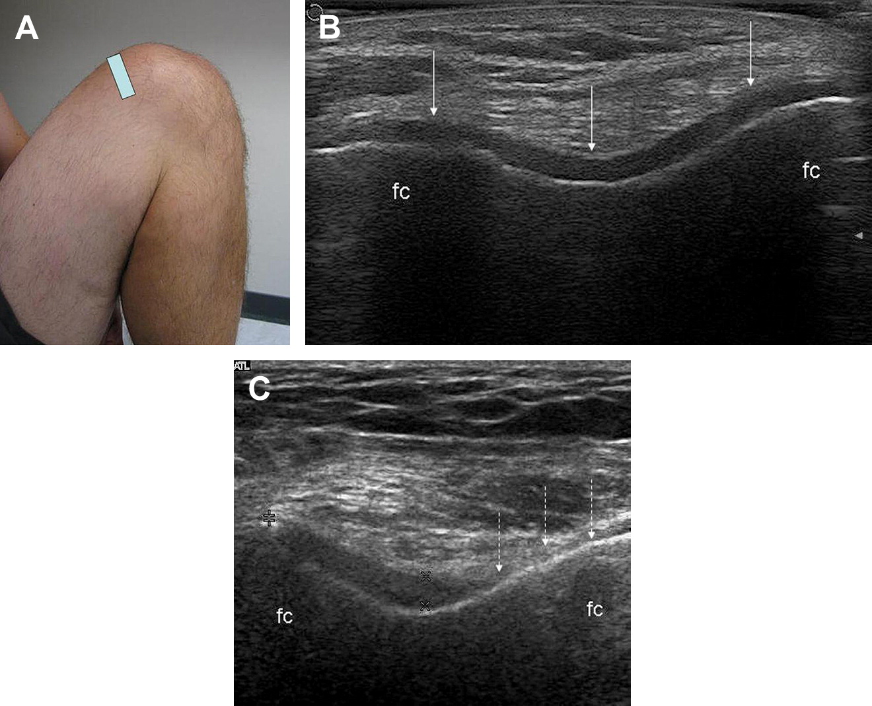
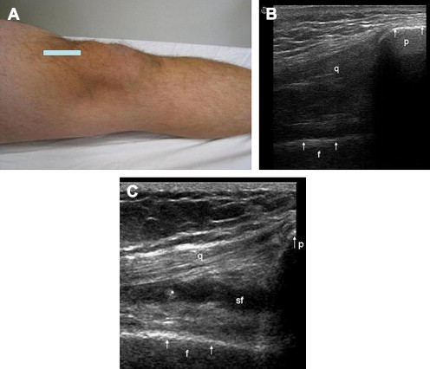
Ultrasound
Cartilage
Tendon
Synovial
Hypertrophy
Synovial
Fluid
Keen HI & Conaghan PG 2009
Notes:
While optical coherence tomography may find a home in the operating room, ultrasound is grabbing a lot of attention in the traditional clinical setting.
Ultrasound images enable us to visualize various tissues like the synovium, tendons, ligaments, and cartilage at some locations.

Slide 36
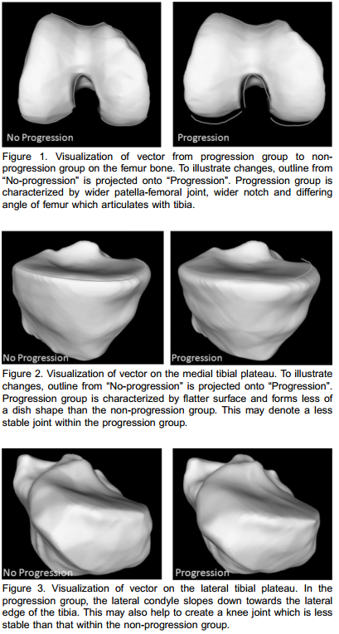
MR-Based Shape Modeling
Bowes M et al 2008, 2011 (OARSI abstract)
Notes:
One final aspect that I’d like to note is that shape modeling, based on various imaging modalities, is clarifying how important bone shape may be in the etiology and progression of osteoarthritis.
While some research has highlighted this fact at the knee perhaps the greatest impact of shape modeling is at the hip where it is quickly becoming apparent that hip shape is a major risk factor for hip osteoarthritis and some athletes may be at risk for having high risk shapes like those associated with femoroacetabular impingement.

Slide 37
Are these imaging markers helping?
New imaging techniques have demonstrated the complex nature of OA as a disease of the whole organ.
  Inspiring new treatment strategies
  Opening the possibility of clinical trials in OA
The FDA is currently reviewing whether MR imaging can be a surrogate outcome in OA clinical trials.
Notes:
By now you can tell there’s a plethora of imaging markers that are available in osteoarthritis and there’s no doubt that in the coming years there will be improvements to these; as well as new outcomes.
But so what? Are all of these new measurements helping? I think they are helping us better understand osteoarthritis as a complex disease that influences all of the tissues in the joint.
A better understanding of how each tissue contributes to osteoarthritis may lead to new treatment strategies which are desperately needed since there is no approved intervention to slow or halt osteoarthritis progression.
Furthermore, once we want to test an intervention these imaging modalities might have an important role in the clinical trials.
For example, the FDA is currently reviewing whether MR imaging assessments of cartilage can be a surrogate outcome for clinical trials.

Slide 38
Where’s the clinical relevance?
Providing more sensitive outcome measures
  Could lead to shorter clinical trials with smaller samples
  Could lead to early diagnostic and prognostic tests
Providing new insight into OA phenotypes and unique characteristics of each patient
  Could lead to more individualized care
Some of these imaging markers may never make it to the clinical setting but their influence will be.
Notes:
In the clinical trials, the newer imaging outcomes may be more sensitive to change than traditional measures which will lead to less costly clinical trials.
And for some imaging outcomes that eventually make it to the clinical setting they may open up the opportunity to have early diagnostic and prognostic tests to determine who is at risk for osteoarthritis progression.
Furthermore, these imaging outcomes are just beginning to be applied to understand OA phenotypes and the unique characteristics of each patient.
One hope is that these new measures will enable us to progress to a point of providing more individualized care.
It’s true that many of these imaging markers may never make it to the clinical setting but I suspect their influence will.

Slide 39

Thank You
The clinical relevance of these measures is just starting to be seen.
Note. No knees were harmed in them making of this presentation.
Notes:
I think this represents an exciting time for biomarkers and imaging markers in osteoarthritis, and that we have not yet begun to optimize their potential in the clinical setting.
Hopefully in a few years I’ll be able to discuss how today’s biomarkers and imaging markers have been integrated into the clinical setting and that there is a new generation of these markers on the horizon that will help us better treat our patients.
Thank you.
27-28 minutes

Slide 40
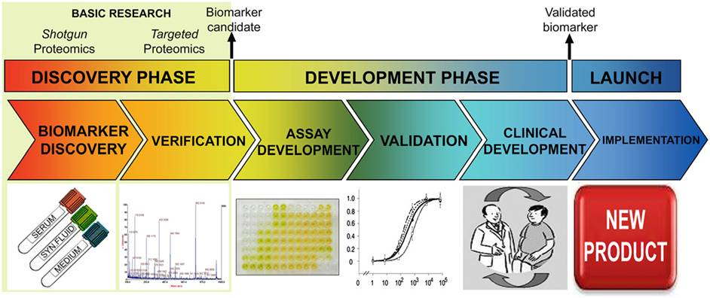
Path of Discovery
Ruiz-Romero 2010

